Slide 1


Culinary Arts Program
Passaic County Community College
Funding administered by project partner:
Office of the Secretary of Higher Education

Slide 2
Agenda
INTRODUCTION
PROGRAM DETAILS
ELIGIBILITY
TIMELINE
QUESTIONS

Slide 3
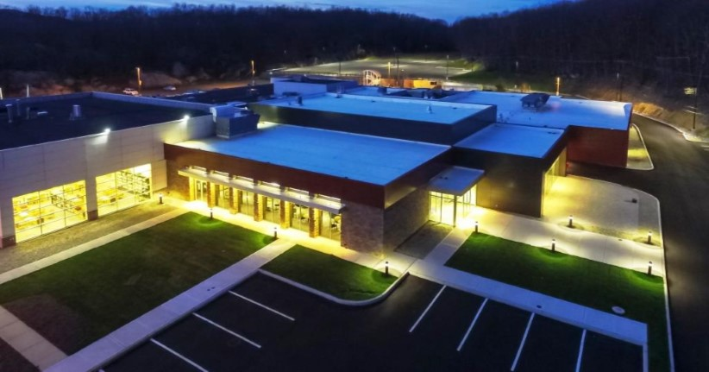
Who we are…
PCCC Center for Adult Transition is a workforce and life skills program that connects companies, high schools, higher education institutions around the shared goal of successful employment for students.
Students served by the Center will receive education and employment preparedness focusing on the Food Industry, a demand industry sector in Passaic County.
The training activities will take place on site at the college’s Wanaque Academic facility, where they have access to a fully- equipped Culinary Arts training facility – 500 Union Ave, Wanaque, NJ

Slide 4
Culinary Arts Job Readiness Training
Students participate in hands-on culinary job training modeled after real-world deli and sandwich shop environments.
As students build proficiency, they develop practical skills in food preparation, sandwich assembly, kitchen safety, and workflow.
Students receive training in essential workplace and life skills needed to succeed in culinary and food service settings.

Slide 5
The Future Of Employment
Student support network
Companies
Career/Life Coach
Culinary Instructors
Higher Education
The PCCC Center for Adult Transition collaborates with the PCCC Culinary Arts Program and other campus partners to provide hands-on job training.
The Center supports young adults with intellectual and developmental disabilities in building the skills needed to secure and maintain meaningful employment.
Employers are facing ongoing labor shortages — including food service, retail, hospitality, and health care — continue to need reliable, well-trained workers. This creates real openings where individuals trained with workplace and culinary skills can fill important roles

Slide 6

Program Details

Slide 7

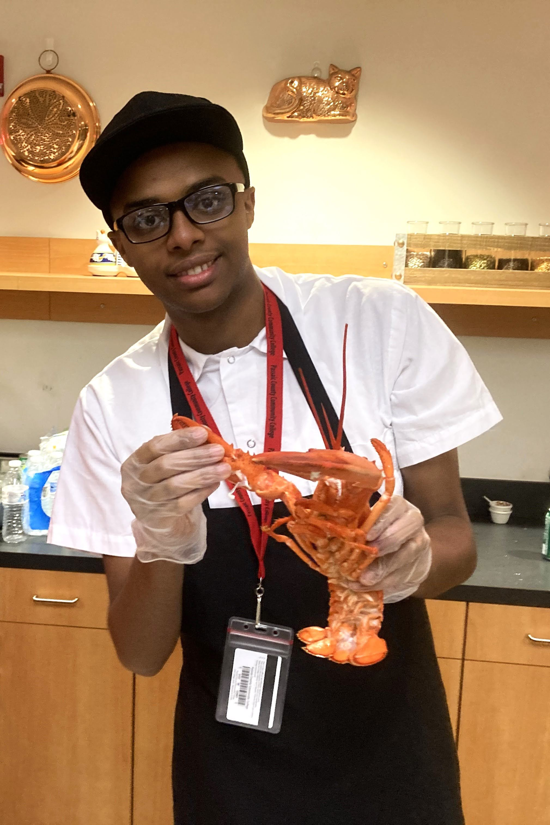
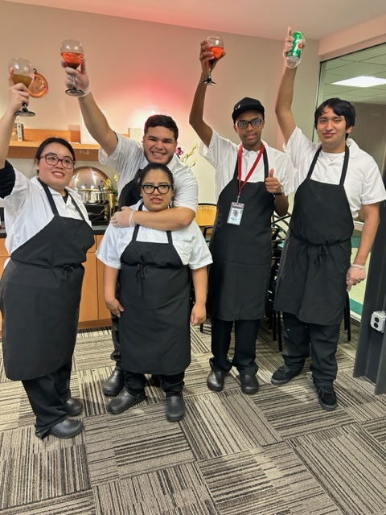
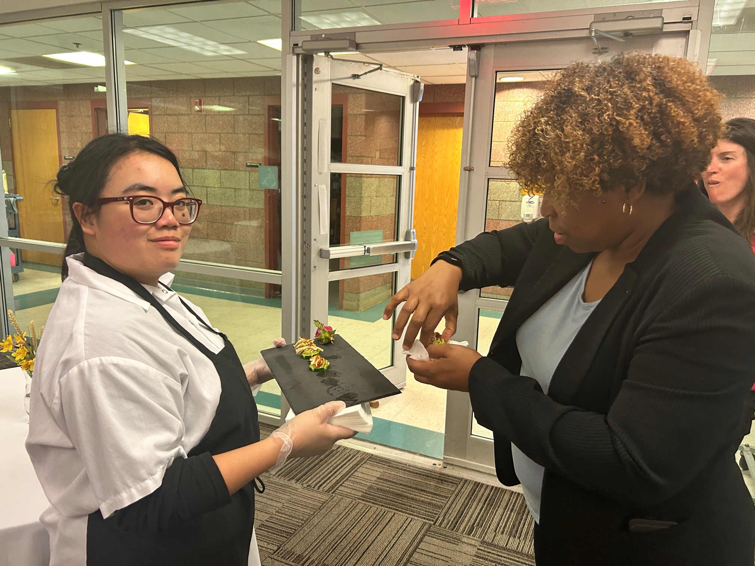
Program Details
The training program will consist of a 10 week, hands-on training program, which will take place 2X a week.
A maximum of six students in each cohort
Classes include topics in Cold/Kitchen Prep, Breakfast Items, Teamwork Adjustment, Basic Nutrition, Resume Development, Professional Dress Interview Skills, Self-Advocacy Skills, etc.
FREE – NO COST AT ALL!

Slide 8
Eligibility
Our program supports students with intellectual and developmental disabilities aged 18 to 24
Must have interest in pursing job in food industry
Must be comfortable working with a team, and working around kitchen equipment (knives, heating appliances, etc.)
Must be able to commit to the entire length of the program
  No more than 4 excused absences
Must have a high school diploma
Must be able to reap the rewards of their hard work and efforts!
Have Fun!

Slide 9
Timeline: Fall 2026
September
Onboarding
October
  Culinary Techniques, Food Industry Basics, Nutrition
November
  Skill specialization workshops, Resume Building, Interview Prep, Application Support

Slide 10
Timeline: Spring 2027
January
Onboarding
February
  Culinary Techniques, Food Industry Basics, Nutrition
March/April
  Skill specialization workshops, Resume Building, Interview Prep, Application Support

Slide 11
How we get there….
Experienced Team
Community Building
Employer Relationships
Our team has combined experience in the industry
Instructors come from backgrounds working in catering, private chefs, executive chefs, restaurant management, teaching, emotional-social support etc.
PCCC has expansive resources across departments to best support students
Our team has a team of resources/contacts in the industry and in the academic world
Students will have the opportunity to increase their networks of support
Transition Fairs & Resource Fairs
HS Partnerships & Transportation
CAT supports students to gain skills to make them more employable
We build long-lasting relationship with employers and agencies (DVRS) looking to hire our students
Job Shadowing Opportunities

Slide 12
Follow us on social Media!!
“A little progress each day adds up to big Results.” - Satya Nani
https://www.instagram.com/centerforadulttransition/
Funding administered by project partner:
Office of the Secretary of Higher Education

Slide 13
Questions?
“A little progress each day adds up to big Results.” - Satya Nani
Lamont Williams
Assistant Director
lkwilliams@pccc.edu
973-684-5801
Funding administered by project partner:
Office of the Secretary of Higher Education

