Slide 1




Slide 2

Woods System of Care is a population health management organization that through its network of providers in PA and NJ provides life cycle care to meet the lifelong needs of children and adults with intellectual disabilities and autism (ID/A), acquired brain injuries and/or mental health challenges who may also have complex medical and genetic conditions.
40,000+
Individuals Served Annually
175
School Districts
Providing Referrals
23
Clients
From 23 States
6,500
Employees
2
States: PA & NJ
12
Affiliates & Partners

Slide 3












Our Affiliates

Slide 4
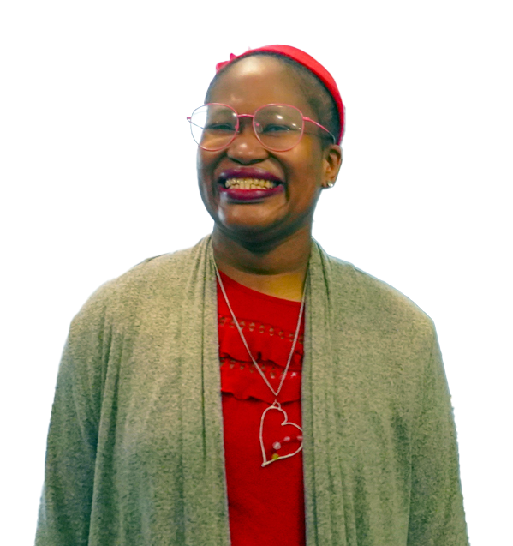
Who We Serve
Intellectual Disability/Autism
Children, adolescents, adults, and aging adults
Behavioral Health
Children, adolescents, adults, aging adults
Complex and Co-occurring Health Conditions
Children, adolescents, adults, aging adults
Homeless or At Risk of Homelessness
Adults
Child-welfare System
Children, Adolescents, and Families
Neuro-typical Children

Slide 5
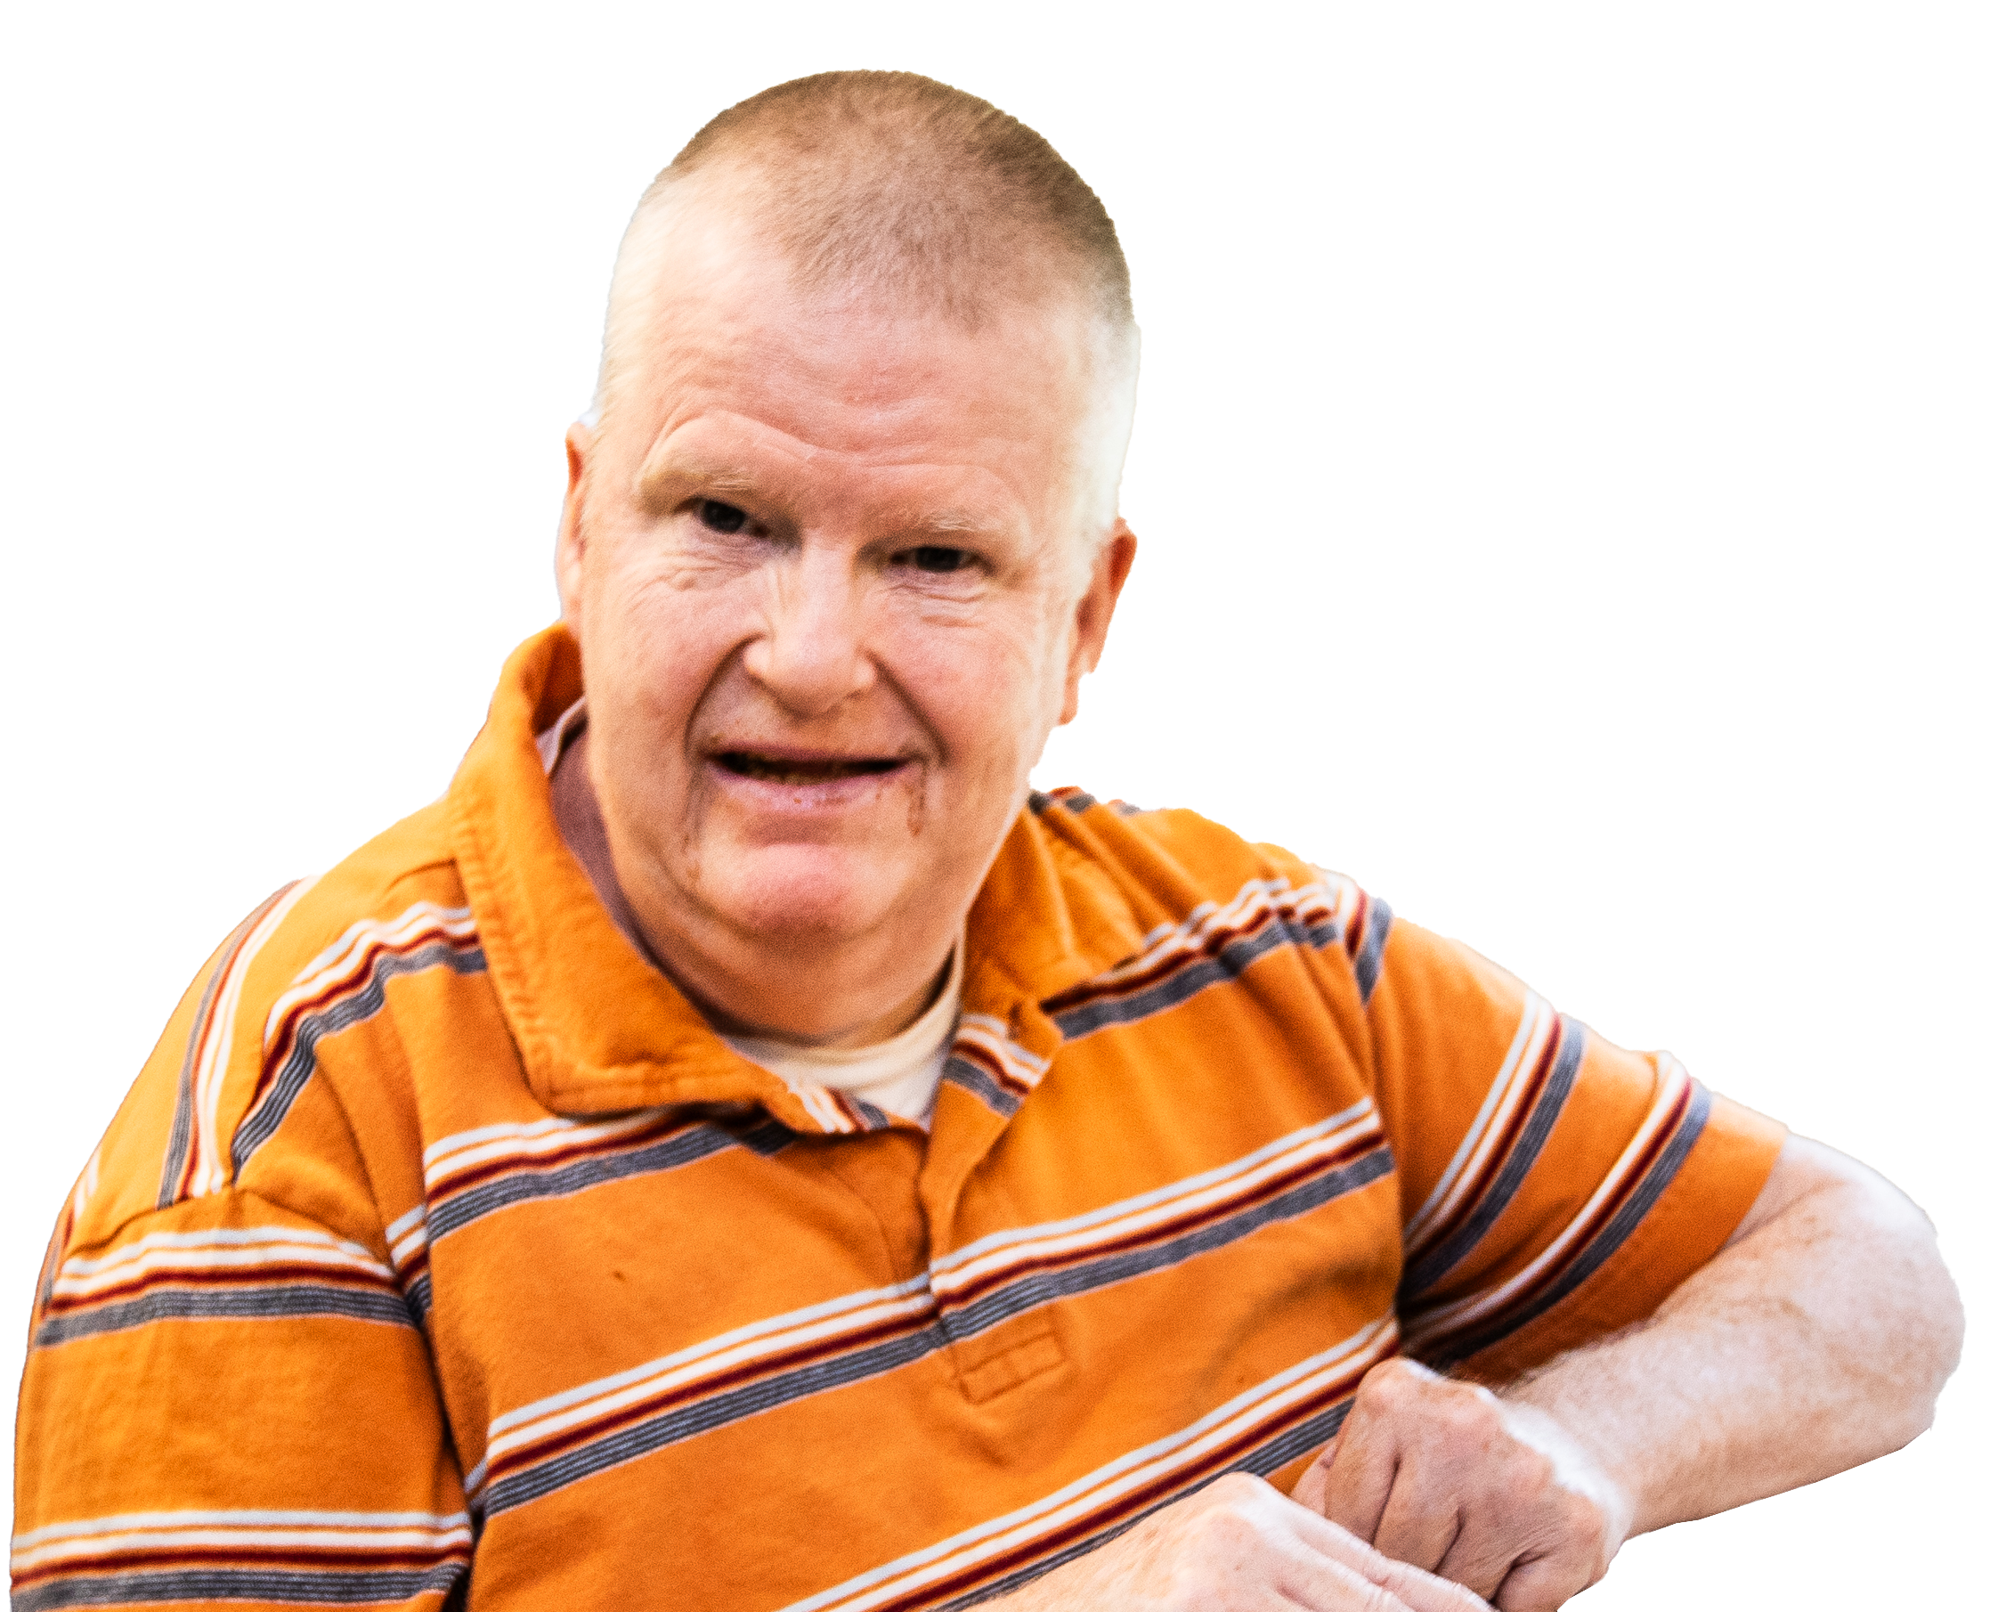
Why We Have Formed a System of Care
61 million people in the U.S. live with a disability.
More than 7 million live with an intellectual disability.
Rates of autism diagnosis are increasing each year (now 1 in 35 among 8-year-olds in NJ).
Number of older adults – and adults over 60 with ID/A increasing.
Systems are fragmented and not integrated.
Providers lack training to treat patients with IDD, autism and complex healthcare needs.
Health disparities and barriers to care persist for complex populations.

Slide 6

Comprehensive Service Array
Nine Special Education Schools
  Before and After School Care
  Prevocational and vocational training and services
Residential Services
  Supervised independent Living
  Foster Care/Lifesharing/Adoption
  Community Group Homes
  Complex Medical and Behavioral Health Homes/Hospital at Home
  Transitional and Long-Term Care
  Children’s Residential Treatment
  Respite Care
  Intensive Residential Supports
Adult Day Habilitation
  Supported Employment, Vocational Services and Partial Care

Slide 7
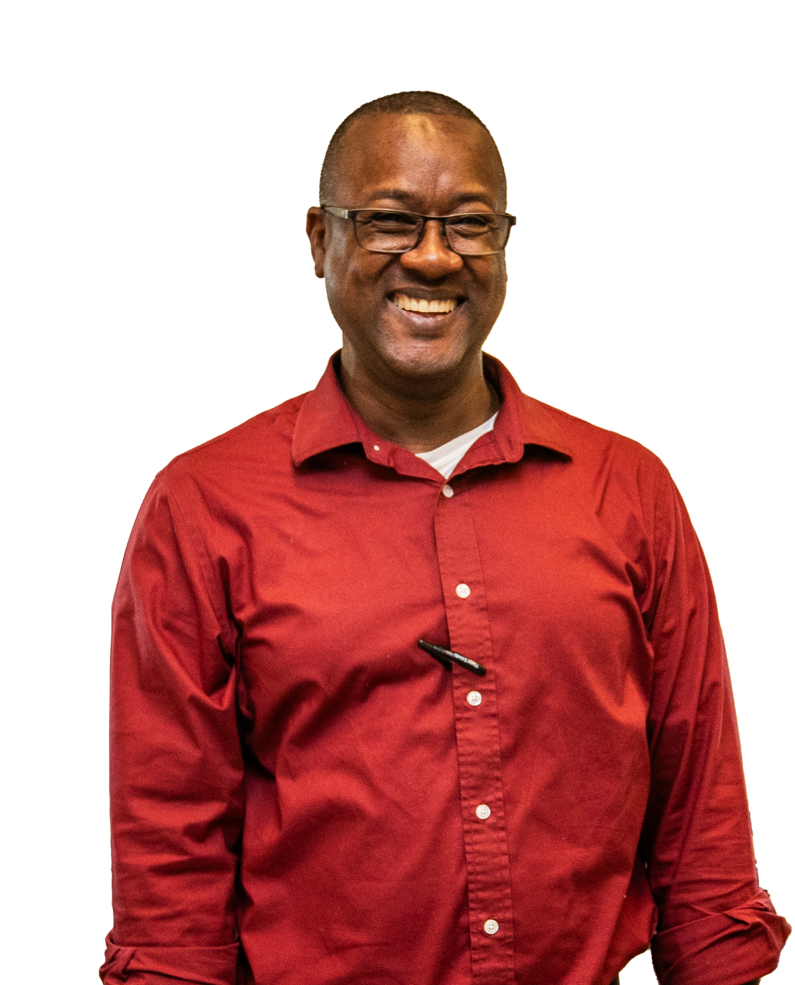
Comprehensive Service Array
Integrated Healthcare (Outpatient and Telehealth)
  Medical – Primary Care, Specialty Care, Behavioral
  Health and Urgent Care
  Dental
Behavioral Health (Inpatient and Outpatient)
  Early Intervention and Diagnosis
  Mobile Crisis Response
  D&A Services and Medication Assisted Treatment (NJ)
  Crisis Intervention
  Psychiatric Residential Treatment and Stepdown Services
  In-patient psychiatric care
  Respite Care
Social Services
  Early Intervention Services
  Recreation
  Intensive Family Support Services
  Integrated Case Management

Slide 8

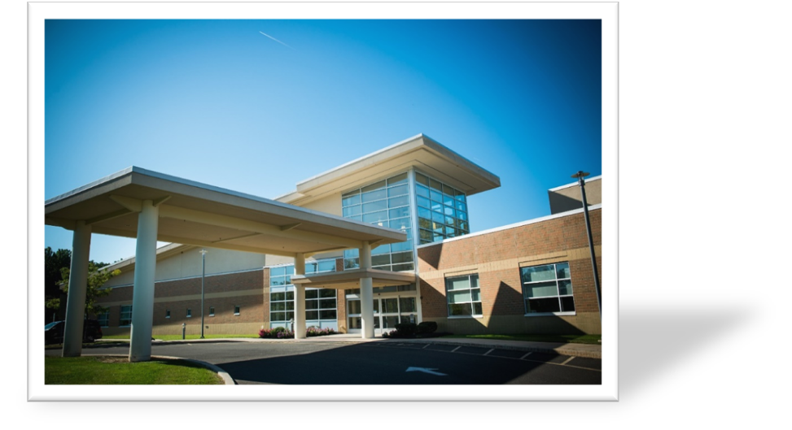
Woods Integrated Care Model
The Medical Center at Woods serves as the model nationally for integrated I/DD and autism care—for the Center at Hamilton and beyond.
Within this model, Woods has a track record of partnering with hospitals and training doctors, nurses, and clinicians.
Primary
Care
Behavioral
Health
Dental
Care

Slide 9
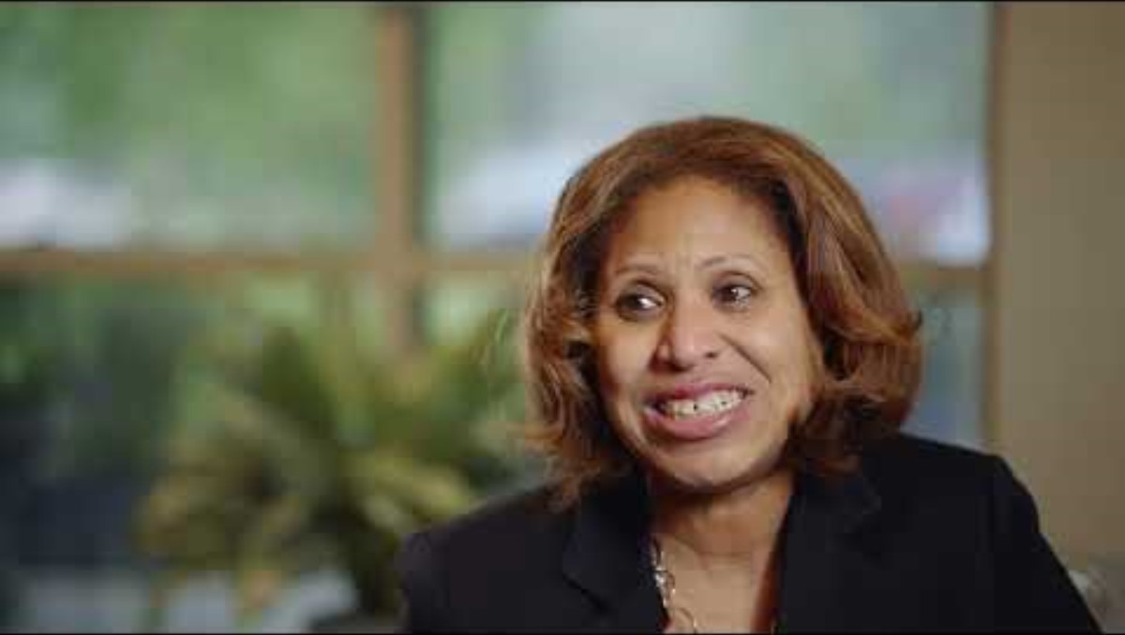
Welcome to Woods at Hamilton

Slide 10
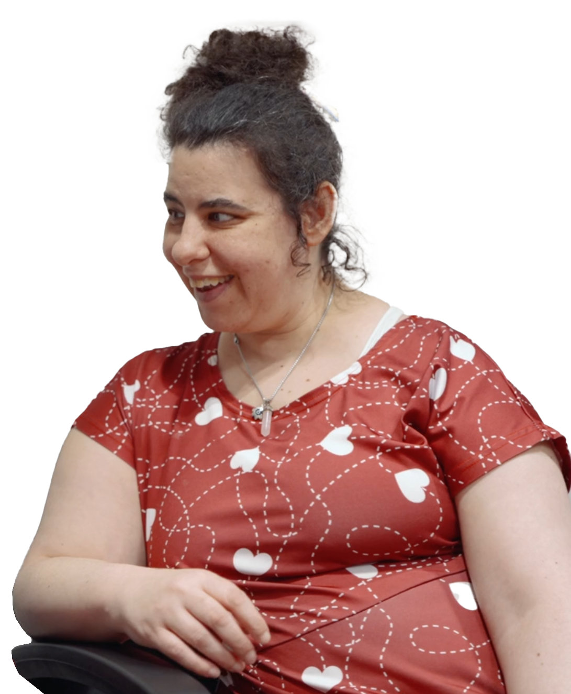
Services Provided
The Center will support those with Intellectual Disability, Autism and other medical complexities along with their families focusing on the 18+ population
  Primary Care
  Same-Day Sick Visits (Acute Illness and Minor Injury Care)
  Wellness and Prevention
  Chronic Disease Management
  Immunizations and Screening
  Medication Management
  Basic Labs
  Behavioral Health Therapy (Spring 2026)

Slide 11
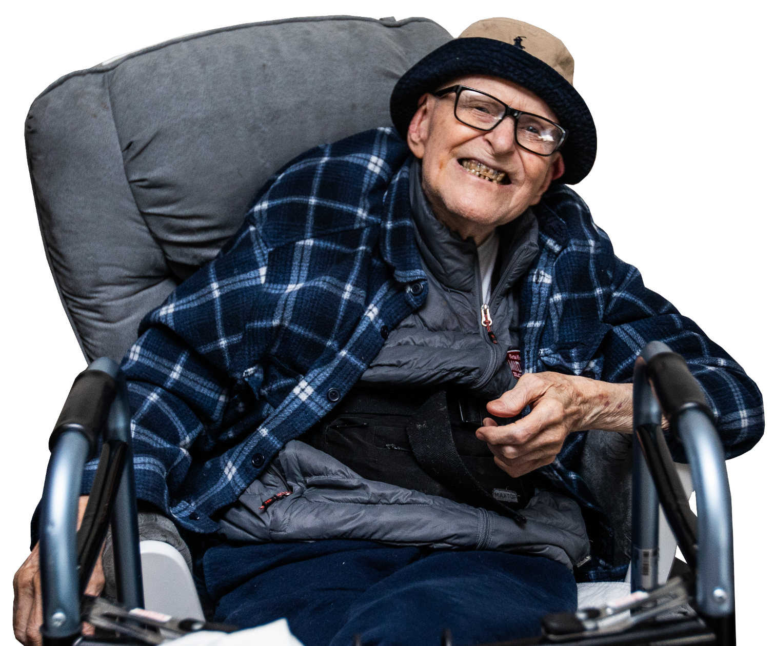
What Sets This Practice Apart?
This center is a joint venture, embedded in Hamilton Hospital.
The first of its kind in the area, the center provides integrated primary and behavioral health, with warm and seamless handoffs to nearby specialists as needed, for individuals with intellectual and developmental disabilities and autism.
Ultimately, this center will minimize unnecessary ER visits and improve quality of life for individuals and their caregivers.

Slide 12
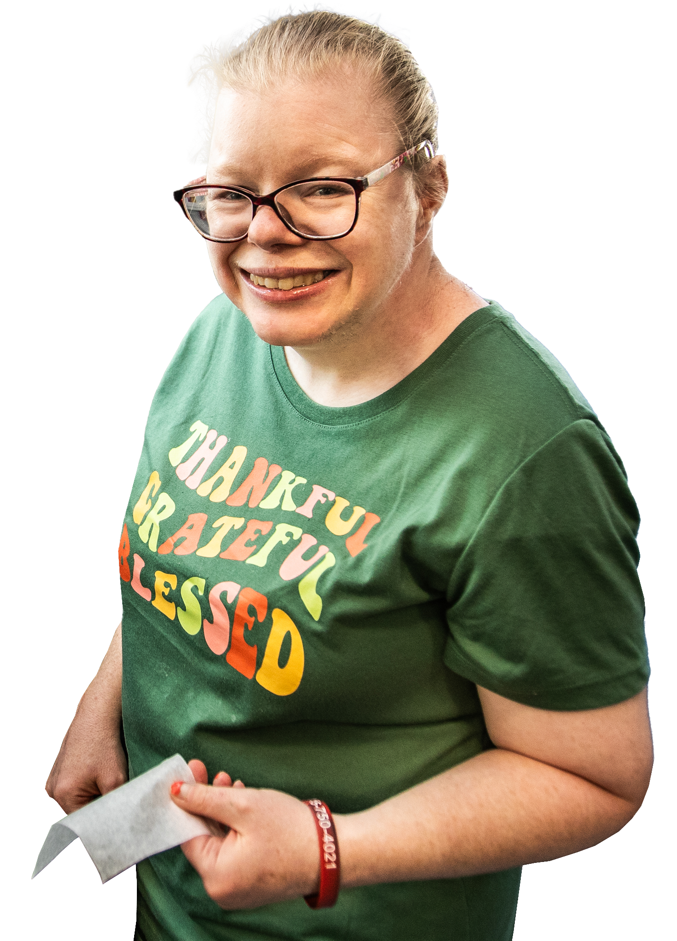
Our Practice
  Fall 2025:
  Primary care with MD and Nurse Practitioners trained specifically to work with this population, and medication management with an on-site Psychiatric Mental Health Nurse Practitioner at least one day per week and overseeing Psychiatrist.
  Clear and constant communication among care team and specialists.
  Spring 2026:
  Addition of on-site licensed therapists who will provide integrated behavioral healthcare—i.e., communicative care with primary providers under one roof.

Slide 13
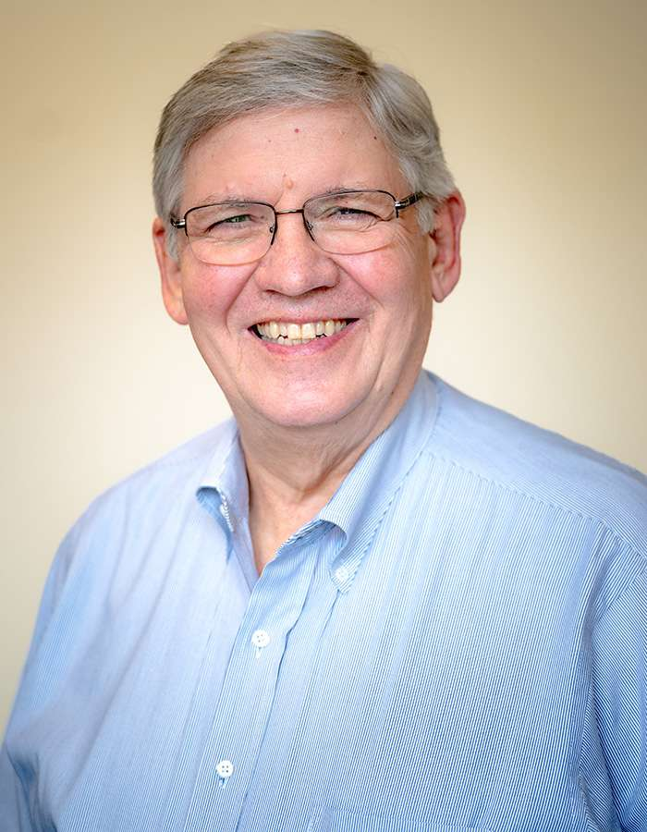
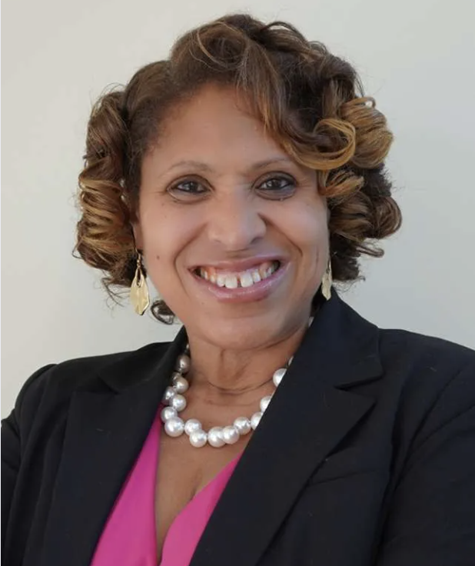
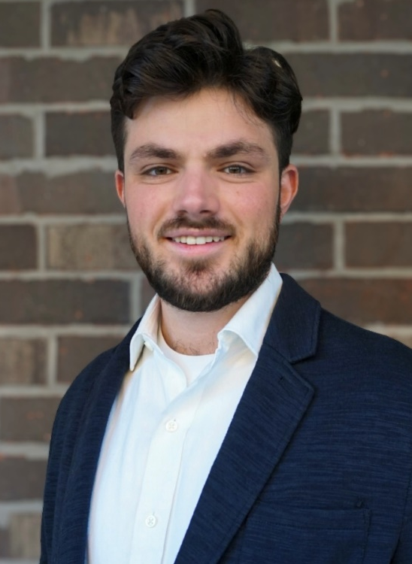
Our Team
Dr. Stephen Kolesk, M.D.
Chief of Family Practice
Woods at Hamilton
Stephen.Kolesk@woods.org
Dinetta Armstrong
Sr. VP, Woods Healthcare
Executive Director, Woods at Hamilton
Dinetta.Armstrong@woods.org
Ethan Diamond
Practice Manager
Woods at Hamilton
888-628-9661
Ethan.Diamond@woods.org

Slide 14
How To Make A Referral
Call with questions or to schedule:
Phone: 888-628-9661/609-249-7688
Fax: 609-249-7695
Email: hamilton@woodshealthcare.org
woodshealthcare.org/Hamilton
Location: 1 Hamilton Place, Suite 501
Designated parking spots in Lot D with clear signage to lead patients to our suite within a 5-minute walk.

