Slide 1

The Achievement Center at
Raritan Valley Community College

Slide 2
What is the Achievement Center?
  The Achievement Center is a Three-Year Certificate-based post secondary education program for students with intellectual and development disabilities. This college program is a collaboration with Raritan Valley Community College and operated by the Arc of Somerset County.
  The Achievement Center is an academic based program to prepare students to transition to college and experience life on RVCC’s campus, while receiving additional support to maximize their success. 32 NEW STUDENTS started this FALL 2025

Slide 3
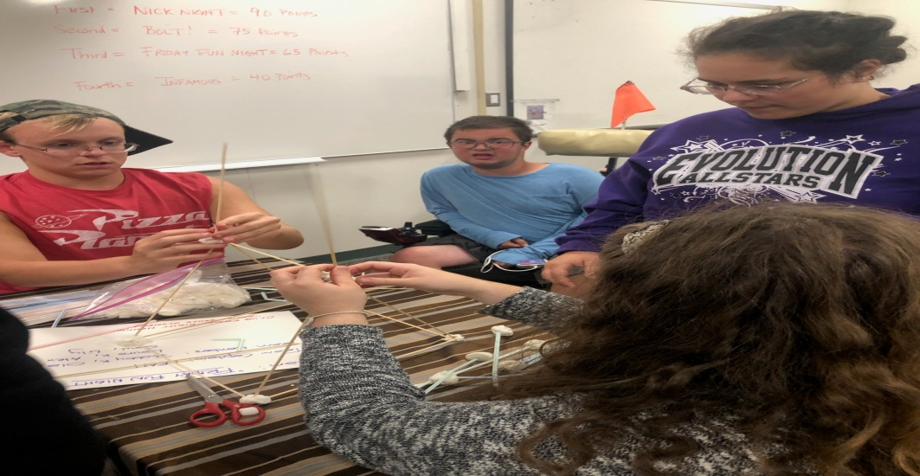
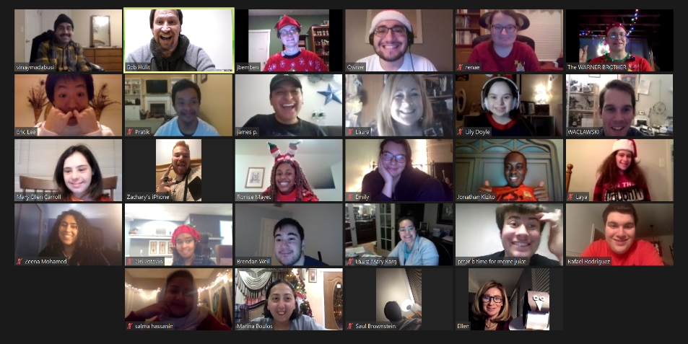
New Developments 2025
In addition, WE INCREASED OUR ENROLLMENT BY 12 PERCENT and INTRODUCED SIX NEW CLASSES TO OUR CURRICULUM.
Overall,187 students WILL PARTICIPATE in The Achievement Center this Academic year between all our program offerings (College Transition Summer classes; Club Friday Night Hangout), and those continuing their post secondary education by enrolling in both our TAC and RVCC classes.

Slide 4
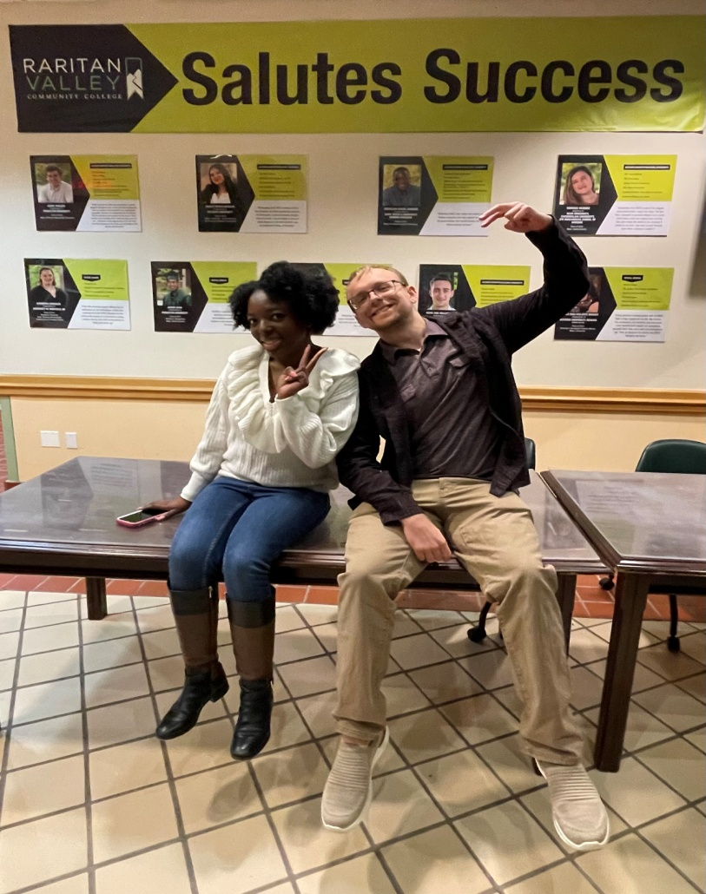
TAC ACHIEVEMENT SCHOLARSHIPS
Two TAC STUDENTS
Rebecca Charles-Estain
and Bobby Kopac
were awarded the
first joint TAC/RVCC Achievement Scholarships for their Academic Performance in 2024.
We have awarded scholarships to Seven Different Recipients

Slide 5
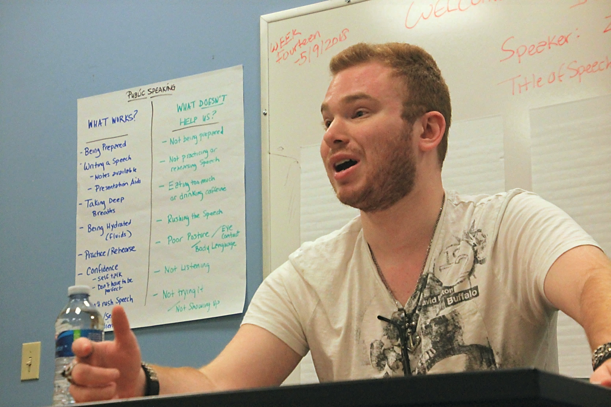
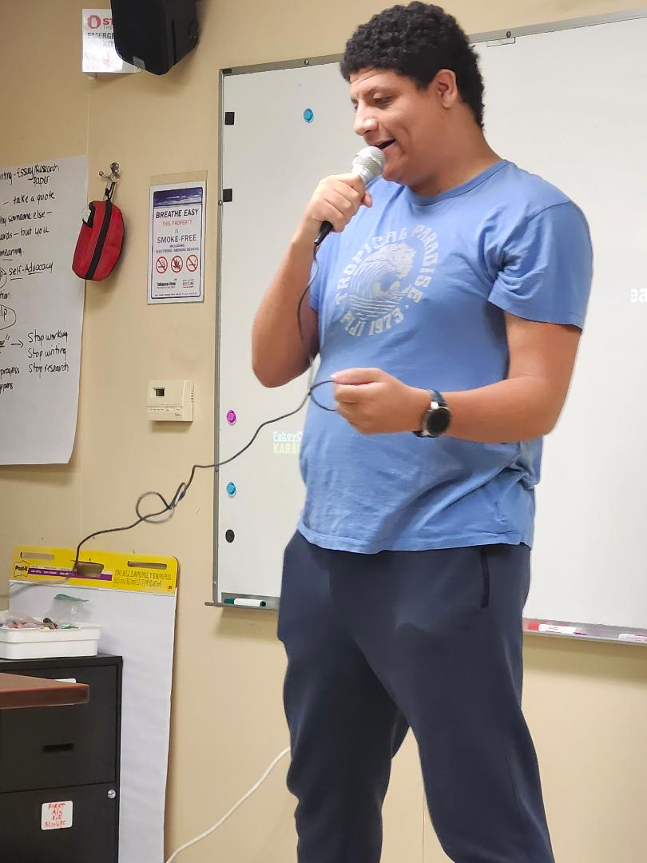
LEARNING YOUR VOICE

Slide 6
CLASSROOM EXPERIENCE
The Achievement Center provides real world college experience inside the classroom. We are an Academic based program.
As with typical college programs, we run our classes in the Fall, Spring, Summer semesters
A typical semester runs 14 weeks with our individual classes running for two hours on a weekly basis.
Students typically take 2 to 3 classes per semester.

Slide 7
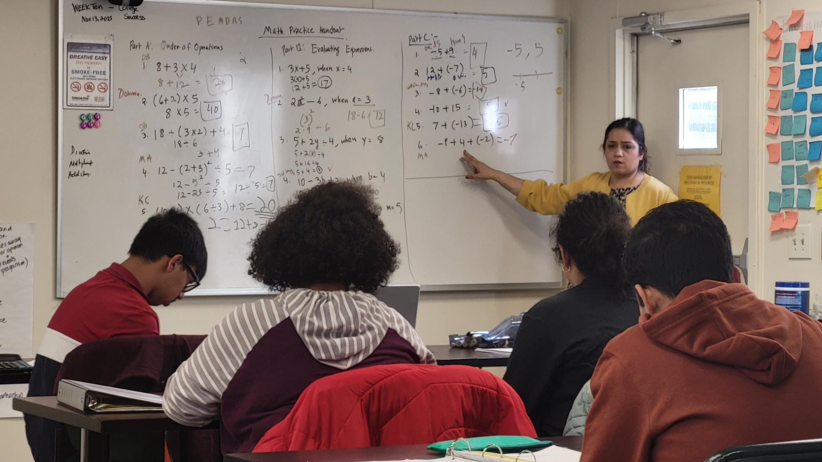
CLASSROOM EXPERIENCE

Slide 8
CLASSROOM EXPERIENCE
Homework Assignments, Readings, Projects, and Discussion/Participation are important parts of inside and outside the classroom
Learning study habits and note-taking skills builds confidence in our students
Our Year Two and beyond students get introduced to Quizzes, Exams, and other writing assignments such as Essays, Research Papers, Speeches and Computer related topics (Powerpoint, Excel, Photoshop).

Slide 9
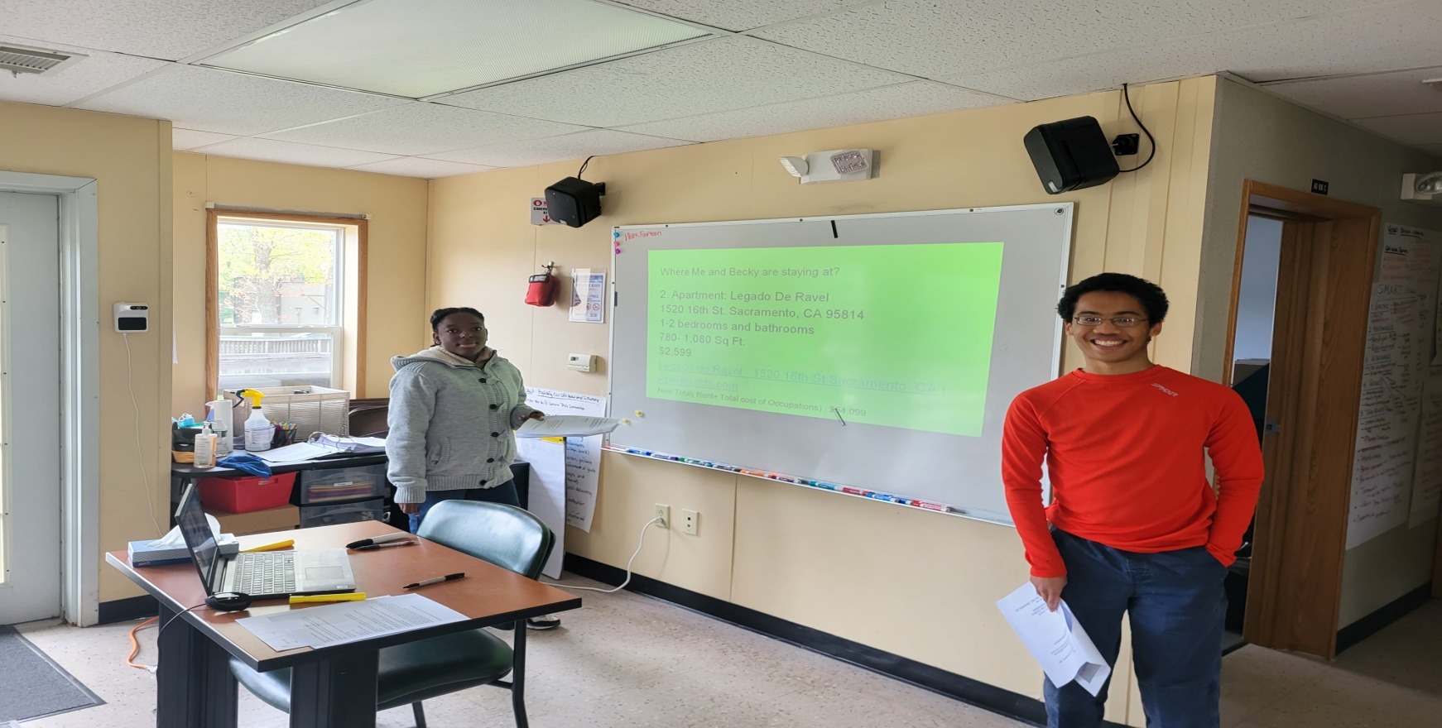
The Achievement Center offers our students an opportunity to “learn their voice” and “seek out new interests” as they acclimate themselves to the classroom and college experience.
Through our series classes, we challenge the students to critically read material (short stories, poetry, novels); explore their writing abilities (Essays, Research papers); communication and social skills training (role plays); career development; and oral presentations. The students build confidence, empowerment, and independence.

Slide 10
TAC = COLLEGE SUCCESS
FROM TAC TO RVCC
Tac successes
SIXTY-FIVE TAC
STUDENTS ARE TAKING
RVCC CREDITED
COLLEGE CLASSES
IN THE 2025
ACADEMIC CAMPAIGN
THE AVERAGE GRADE FOR TAC STUDENTS IN SPRING SEMESTER 2025 WAS
93 (A-)
FIVE CURRENT
TAC STUDENTS
MADE THE RVCC
DEAN’S LIST in the FALL SEMESTER 2025 WHILE TAKING COLLEGE CREDITED CLASSES AT RVCC
SEVEN STUDENTS
GRADUATED TAC in
JUNE 2025

Slide 11
STUDENT ENGAGEMENT
Our TAC Students are pursuing RVCC Certifications and Degrees in Business Management, Computer Support, Criminal Law, Early Childhood Education, Fitness, Game Art, Human Services, Occupational Therapy, and Theatre Arts.
We continued our positive relationship with the RVCC Center for Accessibility and Inclusive Education to ensure our students are getting the appropriate accommodations to help them succeed in the classroom.
EIGHTEEN TAC Students participated and performed in RVCC organized clubs and RVCC theatre productions.
The clubs include ROTORACT, FITNESS CLUB, GAMING CLUB, ANIME, BOWLING CLUB, CRIMINAL JUSTICE, and the YOUNG DEMOCRATS CLUB.

Slide 12
PEER MENTORS
Peer Mentoring at The Achievement Center is designed to provide our college students a “supporting tool” that provides them with learning skills; self advocacy techniques; assistance in navigating the college campus; reinforcement study habits/time management of their course work.
Peer Mentors put an emphasis on person-centered planning and learning for their students. Peer Mentors will meet with their assigned students on a weekly or bi-weekly basis during the semester to help their students on self-determination, advocacy mechanisms, and promote individual learning. Either through face-to-face communication or through our many secure Social Distancing Remote Platforms through, GOOGLE MEETS, CISCO WEB EX and ZOOM.

Slide 13
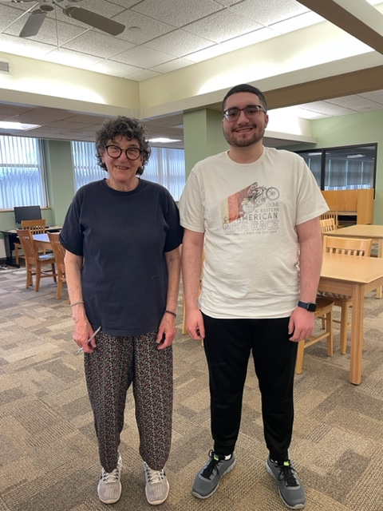
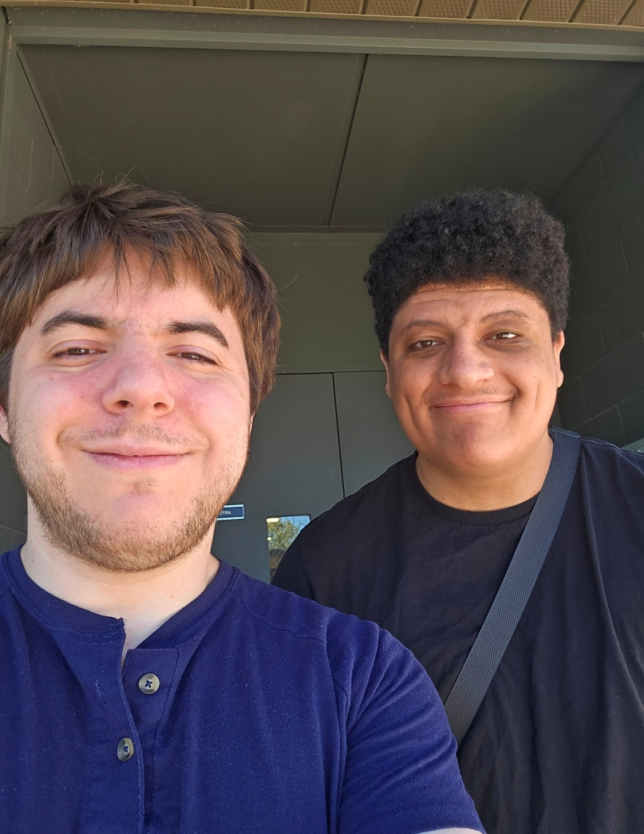
Our Peer Mentors are Raritan Valley current and former students who are aware of the many challenges our students may face both academically (class material/deadlines), and socially (inclusion, confidence-building). In unison with the students, Peer Mentors help identify and develop key skills (Active Listening, Empowerment, Study Habits) for each student.

Slide 14
RISING ENROLLMENT
    The Achievement Center increased its enrollment in the Academic Campaign (Fall/Spring/Summer 2024-25) by 12 percent.
TAC student enrollment covers FIVE COUNTIES – Hunterdon, Middlesex, Morris and Somerset counties
  Hunterdon – 15%
  Middlesex – 25%
  Morris – 3%
  Somerset -55%
  Union – 2%

Slide 15
BOOST in ATTENDANCE
Currently in our Fall Semester 2025, The Achievement Center has seen a steady increase in attendance rates throughout the Summer, Fall, and Spring Semesters. Servicing students from FIVE Different Counties (Hunterdon, Middlesex, Morris, Somerset, Union)
Fall Semester
Fall 2024 Attendance Rate: 98.4%
Fall 2023 Attendance Rate: 97%
Fall 2022 Attendance Rate: 96%*
Spring Semester
Spring 2025 Attendance Rate: 98%
Spring 2024 Attendance Rate: 97.6%
Spring 2023 Attendance Rate: 96%*
Spring 2022 Attendance Rate: 93% *
Summer 2025 Semester 98% Attendance Rate *
* Remote Learning Included

Slide 16
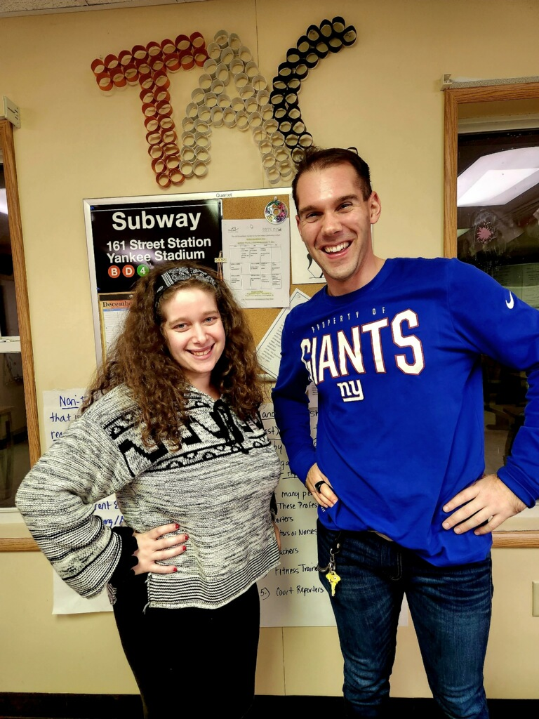
FROM TAC STUDENT to TAC STAFF
LEAH OSSI
AND
NICK WACLAWSKI
WENT FROM TAC
STUDENTS TO
TAC ALUMNI TO RVCC GRADUATES TO NOW WORKING
FOR TAC AS STAFF
TWO MORE TAC STUDENTS WERE HIRED IN 2025

Slide 17
CLUB FRIDAY NIGHT HANGOUT
Club Friday Night Hangout is a Social Skills based activity and recreational program on the campus of RVCC. Through communication, teamwork, and social bonding members practice skill levels in a fun, safe, and interactive environment.
This group is a mix of high school and current Achievement Center students that participate in many different activities: Art Night; Top Chef Night, Social Skills Olympics, Shark Tank Night, Our Annual Talent Show, MURDER MYSTERY NIGHT; and campus related events, such as the RVCC Planetarium.
Started in the Fall 2018 with EIGHT students, Club Friday Night Hangout enrollment has grown to 55 STUDENTS this FALL 2025. A WEDNESDAY SUMMER VERSION started in JUNE 2023 and our enrollment was 46 students in Summer 2025.

Slide 18

STUDENT FILMING
Students and TAC staff act
in series of films for our
CFNH Murder Mystery Night,
Club Friday Terror Trilogy
Series. Parents have even
participating in the films.
This December, we will
be hosting a TAC Film
Festival fundraiser on
Campus at RVCC showing
all three horror films.

Slide 19
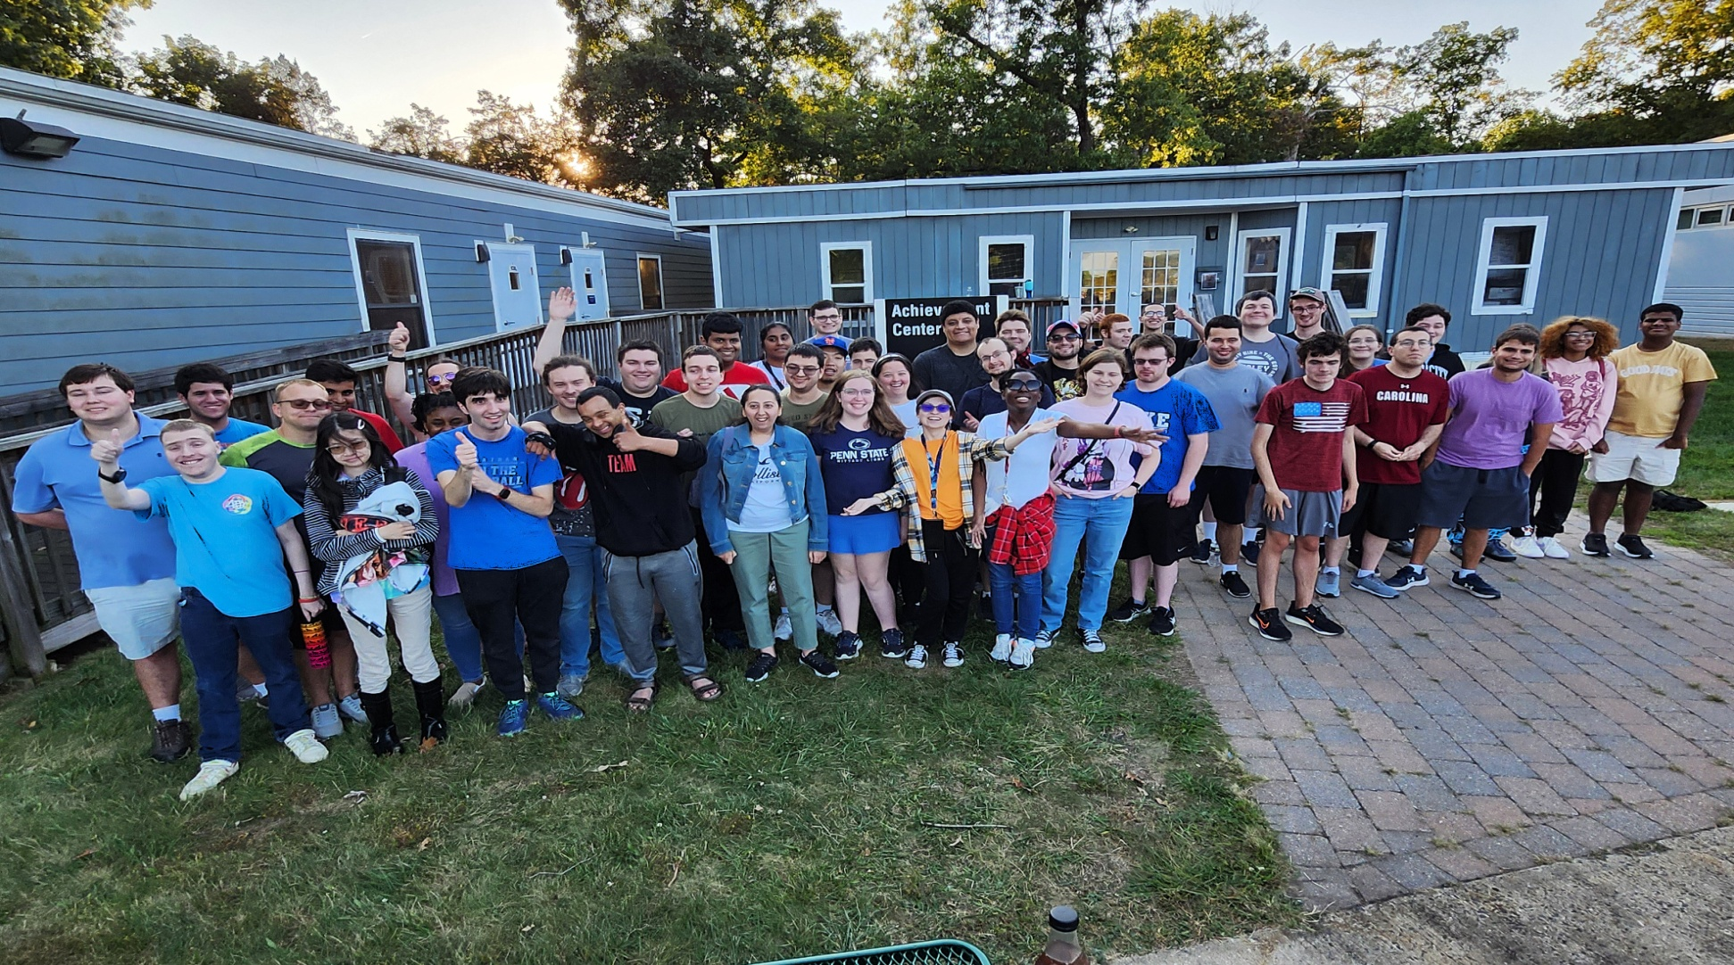
BUILD YOUR SOCIAL SKILLS

Slide 20
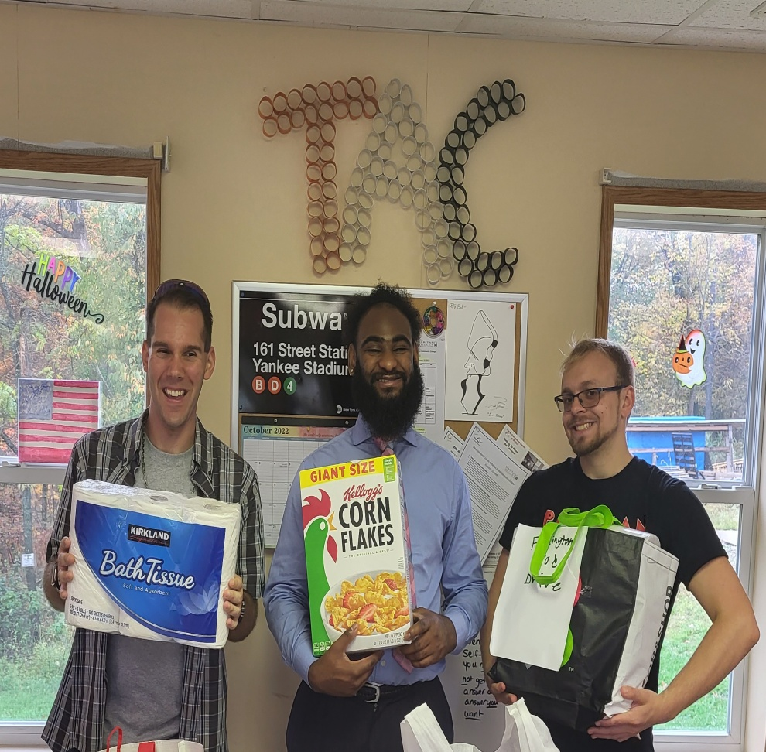
TAC FOOD PANTRY DRIVE
TAC Food Pantry Drive to RVCC Food Pantry and Resource Center. TAC students and families make donations every semester to every Fall, Spring, and Summer Semesters.

Slide 21
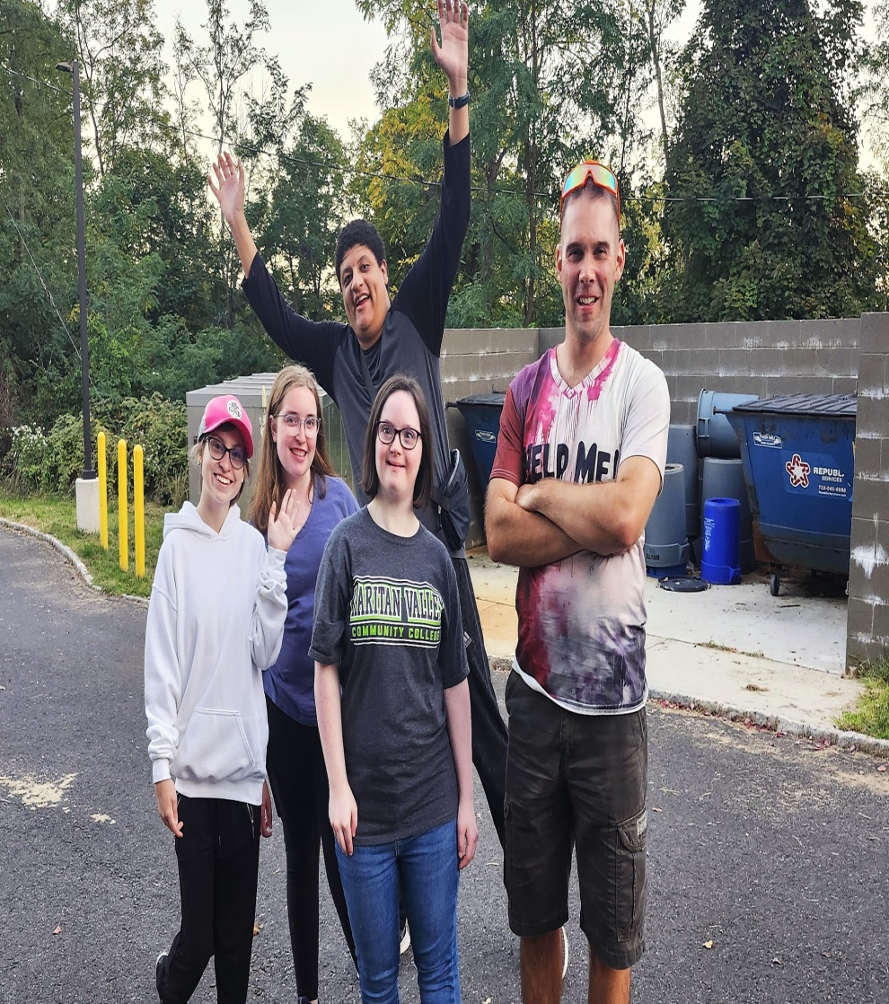
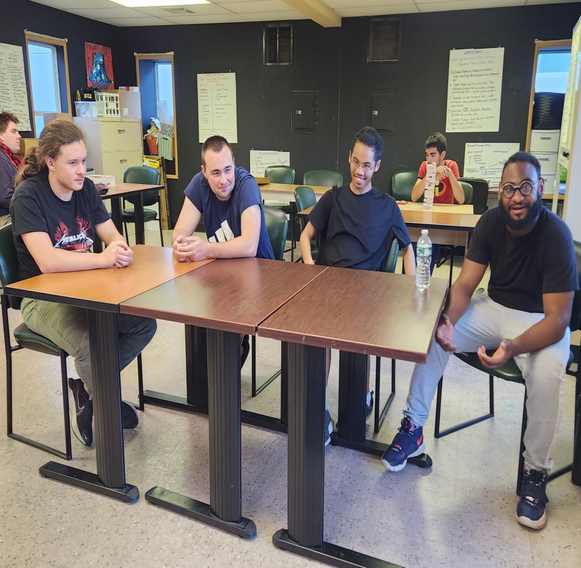
IT’S YOUR LIFE

Slide 22
COLLEGE WITHIN REACH
The Achievement Center at RVCC is waiting for you. Higher education, career development, and social skills awareness are an integral part of a successful education and career paths.
51 STUDENTS GRADUATED TAC. NINE STUDENTS graduated RVCC with Degrees/Certifications.
College provides the time and space for you to plan your life the way you want it. It is expanding your interests, making personal connections, civic engagement, and challenging yourself.
College is Within Reach. Come Achieve With Us. Apply Today.

Slide 23
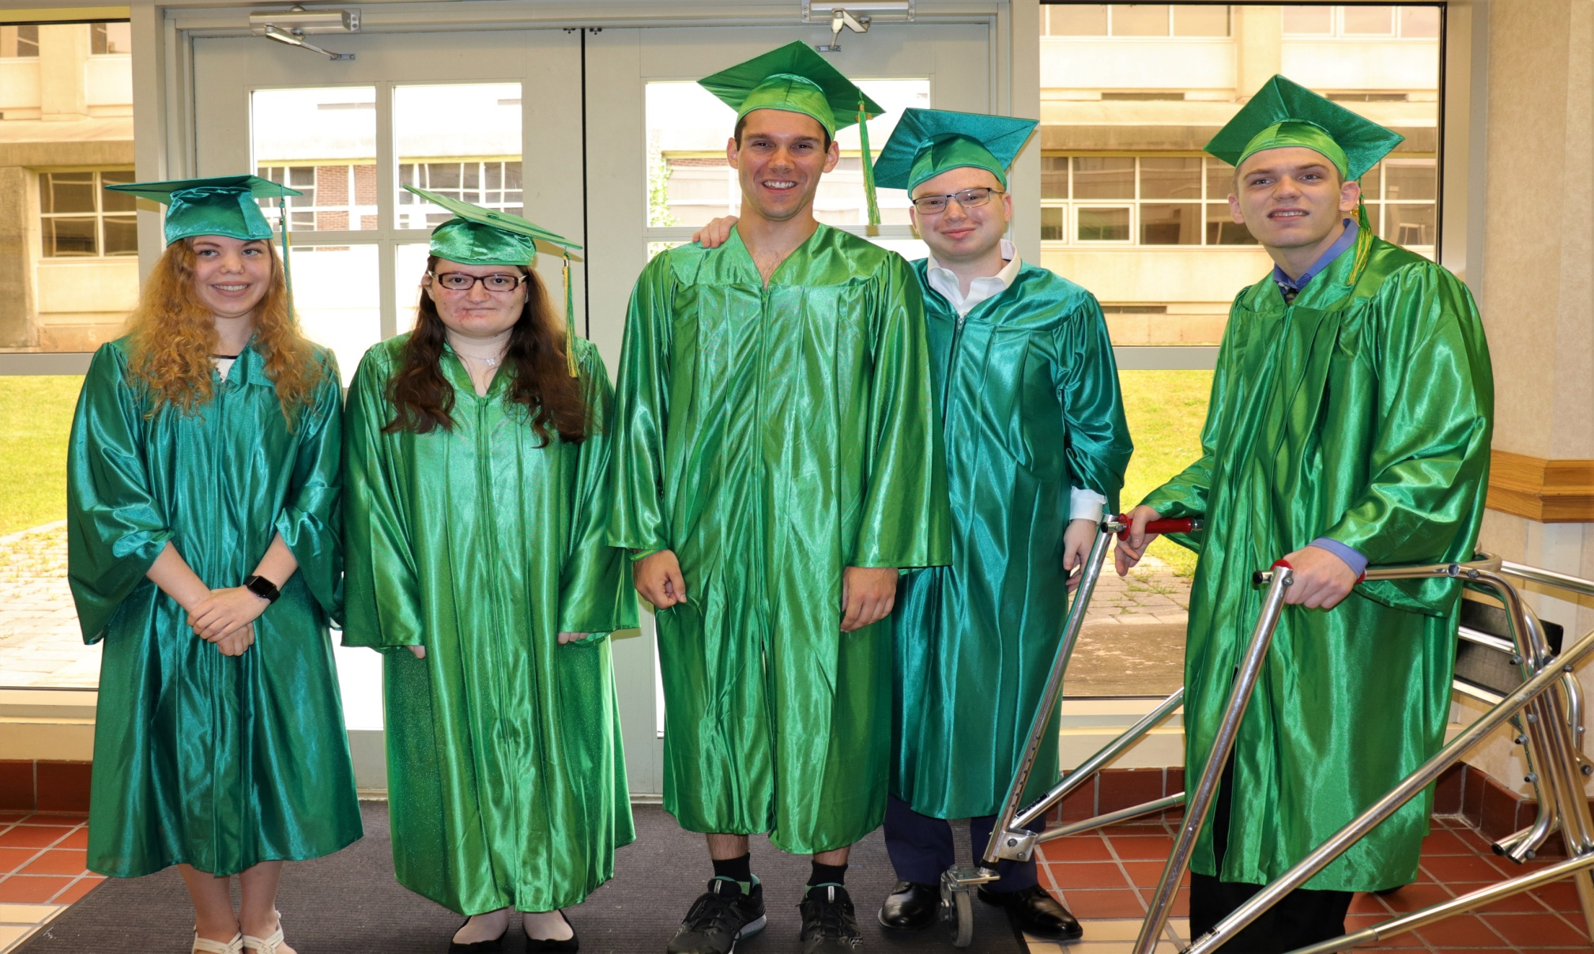
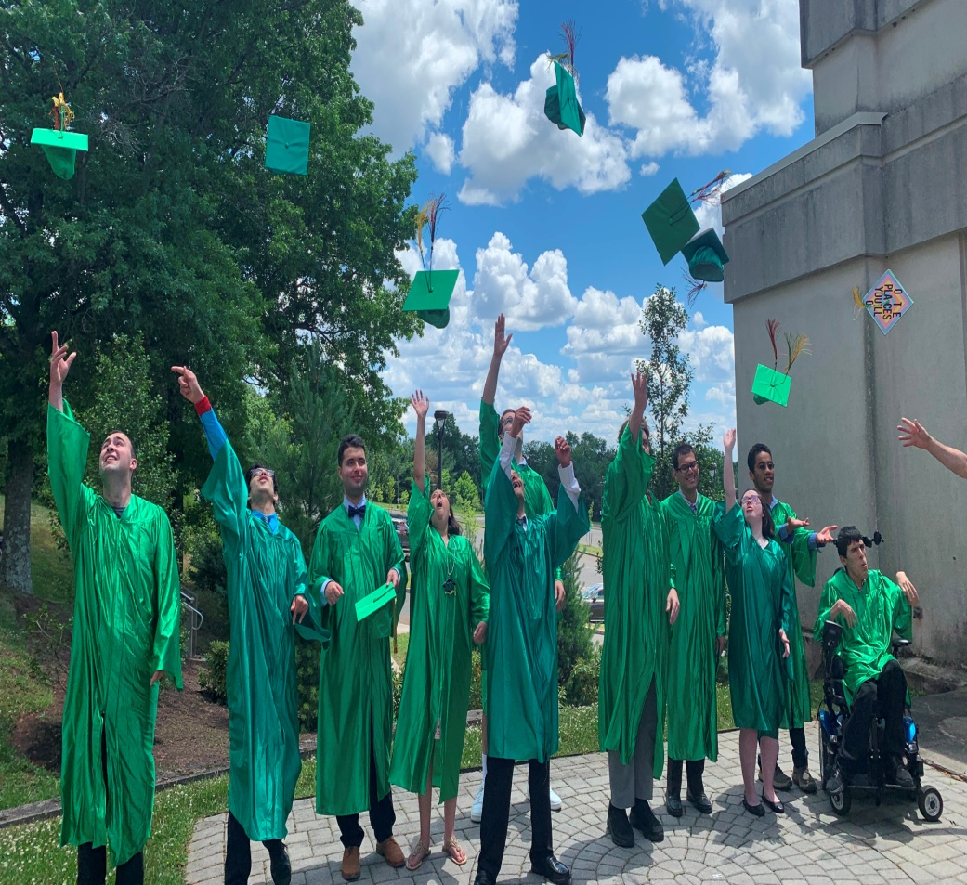
COME ACHIEVE WITH US

Slide 24
Any questions, please call…
Bob Hulit
Director of Post Secondary Programming
2022 Arc of New Jersey Educator of the Year
2021 Somerset County Disability Advocate of the Year
Email: bobh@thearcofsomerset.org
Phone: 732-666-4781
As well as visit The Achievement Center website at https://www.thearcofsomerset.org/the-achievement-center-at-rvcc/

