Slide 1
How Parents’ Social Security
Benefits Impact Their Adult Child with IDD
Connor Griffin, MPH
Director, Health Care Advocacy
The Arc of New Jersey
January 30th, 2024
healthcareadvocacy@arcnj.org
To sign up for listserv:
www.arcnj.org

Slide 2
Main topics to be discussed in this presentation include:
Medicaid “Unwinding”
When a parent is planning to collect Social Security retirement benefits.
Why SSI for son/daughter changes to SSDI.
Social Security’s official definition of a Disabled Adult Child (Section 1634 DAC).
NJ WorkAbility (Medicaid).
ABLE Accounts.
Why Medicare starts for persons with IDD after 24 months of SSDI.

Slide 3
MEDICAID “UNWINDING”

Slide 4
Medicaid “Unwinding”
COVID pandemic started in March 2020, and the federal government declared a Public Health Emergency (PHE) and “continuous Medicaid enrollment”.
From April 2023 to March 2024: 1/12th of the NJ FamilyCare/Medicaid enrollees will receive a renewal application.
EVERYONE WITH IDD MUST CONTINUE TO HAVE MEDICAID TO KEEP THEIR DDD SERVICES!

Slide 5
Medicaid “Unwinding”
Important Note:
Medicaid Unwinding does not apply to people who have SSI & Medicaid.

Slide 6
Medicaid “Unwinding” (cont.)
  What you should do if loved one has NJ FamilyCare/Medicaid:
  Don’t exceed Medicaid’s maximum allowable resources (usually $2,000). This maximum also applies if receiving SSI.
  Exception: If received a back-payment from Social Security – 9 months to spend-down.
  Consider an ABLE account, if appropriate.
  Be sure Medicaid has current mailing address. Call 1-800-701-0710, if need to confirm.

Slide 7
Medicaid unwinding (cont.)
Respond promptly to all letters from NJ FamilyCare/Medicaid. Failure to respond can result in Medicaid termination!
If notified by Social Security that loved one’s current SSI and Medicaid will end, don’t delay in submitting necessary paperwork to Medicaid!
For additional information on Medicaid unwinding, sign up for our listserv and visit the Health Care Advocacy page: www.arcnj.org

Slide 8
WHEN A PARENT IS PLANNING TO COLLECT SOCIAL SECURITY RETIREMENT BENEFITS

Slide 9
Social Security for parents -- “full” retirement age
If born between 1943 and 1954 – age 66 for full retirement benefit for the employee.
If born between 1955 and 1960 – the age increases gradually beyond 66.
If born 1960 or later – age 67 for full benefit.
Parent can collect Social Security as young as age 62, with reduction in benefit; if wait to age 70, increased benefit.
See this retirement planner link from SSA.gov
https://www.ssa.gov/benefits/retirement/planner/agereduction.html

Slide 10
What is the difference between SSI and SSDI?
SSI is Supplemental Security Income. The determination is based on having a severe disability and very limited income and resources.
SSDI is Social Security Disability Insurance. It is based on Social Security’s determination of a disability and also on work credits. A Section 1634 “DAC” is a disabled adult child who receives SSDI from the parent’s work record.

Slide 11
Sometimes a son/daughter has SSDI and never had SSI
If a parent collects Social Security retirement, or becomes disabled, or passes away BEFORE the son/daughter with IDD turns 18, it is likely that the child is not receiving SSI.
If younger than age 18, the Social Security money the child receives is either:
  Social Security Disability Insurance (SSDI) calculated on the parent’s work record, or
  A survivor’s benefit, calculated on parent’s work record.

Slide 12
WHAT HAPPENS TO SSI & MEDICAID FOR SON/DAUGHTER WHEN A PARENT STARTS TO COLLECT SOCIAL SECURITY RETIREMENT BENEFIT (OR WHEN A PARENT BECOMES DISABLED OR PASSES AWAY)?

Slide 13
SSI and Medicaid in NJ
Majority of adults (18 and older) with IDD have SSI and Medicaid.
When individuals have SSI, they have Medicaid automatically, without a separate Medicaid application.
There are changes to the son/daughter’s SSI & Medicaid when a parent collects Social Security retirement, or if parent becomes disabled or passes away.

Slide 14
Important Information!
Previously: When a person with IDD had SSI and then a parent retired, became disabled, or passed away – the switch to SSDI and DAC status was automatic.
Currently: Parents are being told they need to do a new application to Social Security before DAC status takes place.
Some reports of denial for DAC status because sufficient information was not provided to Social Security to “prove” disability status before age 22. Very troubling!
  If individual has Down syndrome, it is easier to be approved for SSDI.
Important to save all medical & IEP documents from when SSI is approved, to provide during a Social Security re-application process!

Slide 15
More Important Information!
If your son/daughter needs DDD services, then they must have NJ FamilyCare/Medicaid. Therefore, when SSDI starts, their resources cannot exceed $2,000. This is a Medicaid rule, not a Social Security rule.
Families should be aware that Social Security employees don’t know that NJ Medicaid is required for DDD services. Do not pay attention if Social Security employee says there is no resource maximum for people who receive SSDI.

Slide 16
SOCIAL SECURITY’S
OFFICIAL DEFINITION:
SECTION 1634 DAC –
(DISABLED ADULT CHILD)

Slide 17
Why is it Helpful to Have SSI?
When parent of person with IDD retires, becomes disabled, or dies: If the son/daughter has SSI, they are able to receive Social Security Disability Insurance (SSDI) income on parent’s work record, instead of SSI.
Monthly SSDI on parent’s work record is often too high to get Medicaid.
But, when persons with IDD previously had SSI, they are “Disabled Adult Children: Section 1634 DACs”, as defined by the Social Security Admin. They are eligible to get Medicaid again, after they start receiving SSDI on parent’s work record. The amount of the SSDI benefit is ignored.

Slide 18
Official Definition: Section 1634 DAC
DAC = Disabled Adult Child. See Section 1634 DAC flyer developed by NJ DHS. Flyer was revised, Sept. 2021.
Social Security Admin. (SSA) definition of a DAC:
  A person who was receiving Supplemental Security Income (SSI) benefits (and Medicaid) and who meets the following:
  Is at least 18 years of age;
  Has blindness or a disability which began before the age of 22;
  Has been receiving SSI based on blindness or disability; and
  Has lost SSI due to the receipt of Social Security benefits on a parent’s record due to the retirement, death, or disability of a parent.
Also, the person cannot have more than $2,000 in resources in his/her name (not including a Special Needs Trust or ABLE account).

Slide 19
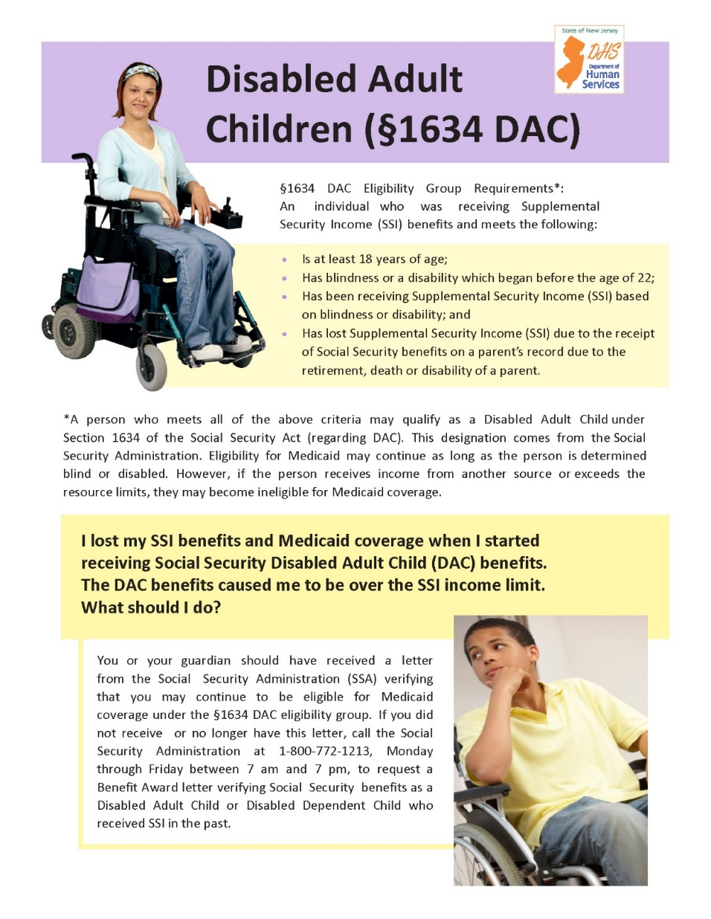

Slide 20
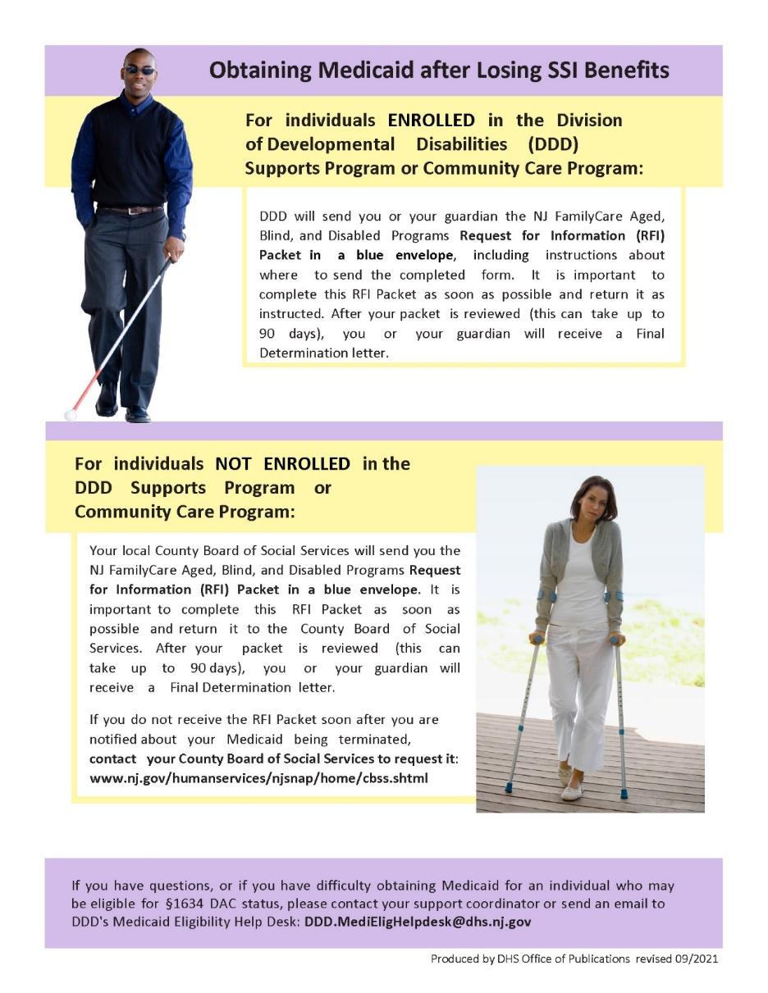

Slide 21
How to obtain Medicaid after becoming a Section 1634 DAC, and SSI benefits end
For individuals ENROLLED in the DDD Supports Program or Community Care Program:
DDD will send the NJ FamilyCare Aged, Blind, and Disabled Programs Request for Information (RFI) Packet, which includes instructions about where to send the completed form. It is important to complete this RFI Packet as soon as possible and return it as instructed. After your packet is reviewed (this can take up to 90 days), you will receive a Final Determination letter.

Slide 22
How to obtain Medicaid after becoming a Section 1634 DAC, and SSI benefits end
For individuals NOT ENROLLED in the DDD Supports Program or Community Care Program:
Your local County Board of Social Services should send you the NJ FamilyCare Aged, Blind, and Disabled Programs Request for Information (RFI) Packet in a blue envelope. It is important to complete this RFI Packet as soon as possible and return it to the County Board of Social Services. After your packet is reviewed (this can take up to 90 days), you will receive a Final Determination letter.
If you do not receive the RFI Packet from the County BOSS, contact that office to request it: www.nj.gov/humanservices/njsnap/home/cbss.shtml

Slide 23
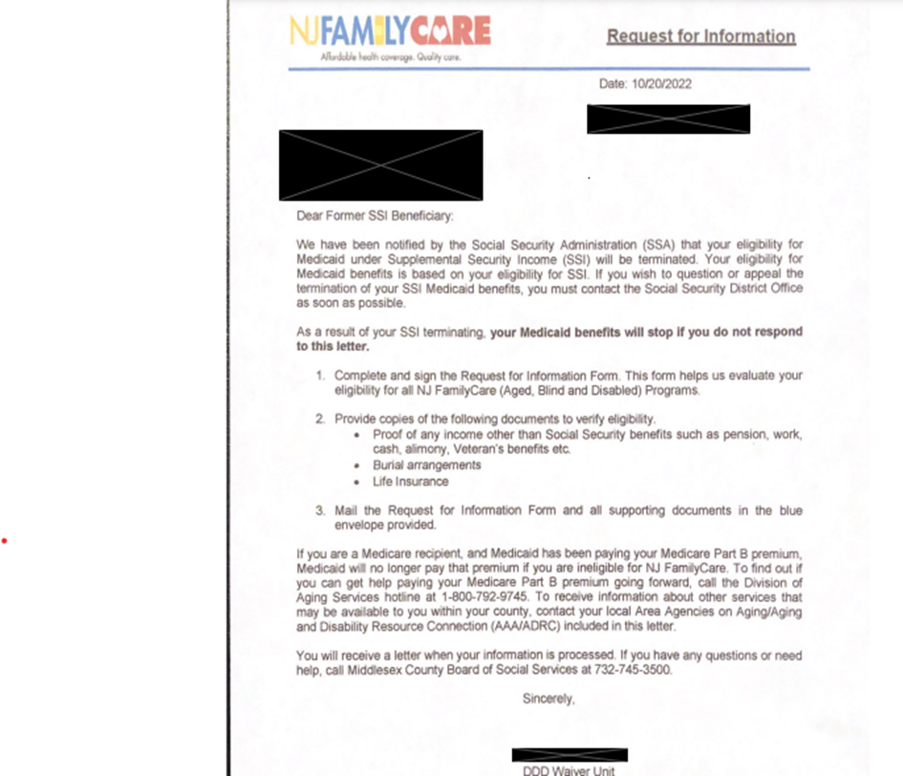
Form Letter Sent by DDD When Person is Changing from SSI to SSDI

Slide 24
Important when applying for NJ FamilyCare/Medicaid as a DAC
1. “NJ FamilyCare” and “Medicaid” are the same! Some notifications may say “NJ FamilyCare”; others may say “Medicaid;” and others use both terms.
2. The first page of the Medicaid application for a new DAC needs to say Request for Information or RFI.

Slide 25
Important when completing RFI application for Medicaid!
A question on page 1 of the application asks if applicant needs Long-Term Services and Supports such as dressing, bathing or mobility assistance. The answer is “no.”
A “yes” answer leads to a huge problem and delay in Medicaid approval because Medicaid staff may think person needs nursing home care!

Slide 26
When applying for Medicaid…
When SSI/Medicaid is ending due to parent’s retirement (or due to parent’s disability or passing away):
Son/daughter with IDD cannot have more than $2,000 in resources with these exceptions:
  Funds in ABLE account (up to $18,000 deposited per year)
  Funds in a Special Needs Trust
  If back-payment received from Social Security: Nine months to spend it down.
Important: The previous Medicaid (from SSI) is in effect for 4 months after SSI ends. Don’t delay in submitting the RFI Medicaid application!

Slide 27
Having both SSI and SSDI at the same time
Example of having both SSI and SSDI simultaneously:
Person with IDD receives SSI and Medicaid at age 18.
Later, a parent with a small work record retires or becomes disabled. Parent receives $900/month in Social Security benefit.
Person with IDD starts to receive SSDI: ½ of $900 = $450/month.
Person with IDD will receive reduced amount of SSI, and $450/month in SSDI. Person with IDD keeps Medicaid because they still have some SSI. RFI Medicaid application is not applicable in this situation.

Slide 28
Special Needs Trusts (SNT)
If setting up SNT, be sure the attorney is very experienced with this type of trust for Medicaid beneficiary.
If the SNT has been funded, Medicaid will want to review the document.
Whenever there are expenditures from SNT, save all receipts. Follow Medicaid regulations.

Slide 29
SOME PEOPLE WITH IDD WHO ARE EMPLOYED HAVE NJ WORKABILITY MEDICAID.

Slide 30
NJ WorkAbility
Medicaid Expansion
Phase 1: Implemented on April 1, 2023:
Allows for continuation of NJ Workability for 12 months after a job loss (through no fault of the employee)
Resource limits were eliminated.
Can keep NJ WorkAbility after 65th birthday.
Removes consideration of spouse’s income.
Can have IRA or 401k retirement account (this is not new; was already allowable).

Slide 31
NJ WorkAbility
Medicaid expansion
Phase 2 implementation: No date has been announced yet.
Is expected to remove the regulation stating that a person is not eligible for NJ WorkAbility if receives “unearned” SSDI income above $1,215/month (in 2023) from parent’s work record.
Note: The $1,215/month threshold pertains only to NJ WorkAbility Medicaid. The $1,215/month limit is not applicable for people who have Section 1634 DAC status and are employed.

Slide 32
IMPORTANT:
WHAT TO KNOW WHEN A
SON/DAUGHTER WITH IDD RECEIVES SSDI AND IS EMPLOYED

Slide 33
What is SGA?
Social Security Administration’s regulation: To be eligible for SSDI benefits, a person must not be able to engage in substantial gainful activity (SGA). A person who is earning more than a certain monthly amount is usually considered to be engaging in SGA.
SGA maximum for 2024 is $1,550/mo. gross income. SGA is income from employment; does not include SSDI income.
Report income from employment monthly to SSA.
If employee with IDD receiving SSDI exceeds SGA for 9 months: Expect to have SSDI halted and receive a letter from Social Security requiring pay-back for overpayment.
Important: SSA is very delayed in sending notifications when persons with SSDI exceeded the SGA level.

Slide 34
ABLE ACCOUNTS

Slide 35
Achieving a Better Life Experience
(ABLE) Act of 2014
Persons with disabilities can deposit up to $18,000/year in an ABLE tax-exempt savings account.
Eligibility: Must be receiving SSI or SSDI; Age of onset of disability must be before age 26.
After SSDI starts (if difficulty spending the additional money), opening an ABLE account may be helpful.
ABLE accounts won't affect continuing financial eligibility for Medicaid, SSI and other public benefits.

Slide 36
Important to monitor ABLE account statements
It is prudent to monitor the monthly ABLE account statements, as you would with a regular bank debit or credit card.
If you see any unauthorized purchases, report it to the bank.
They will investigate, and the account holder will be reimbursed for any unauthorized charges.

Slide 37
ABLE Accounts (cont.)
  Can open ABLE account in NJ or another state. https://savewithable.com/nj/home.html
  Visit the ABLE National Resource Center website www.ablenrc.org, for state-specific information. Great webinars and state-by-state comparisons.
Important: Upon the death of the beneficiary, the state in which he/she lived may file a claim for all or a portion of the funds in the ABLE account to recoup costs paid by the state while the beneficiary was receiving services through the state Medicaid program.

Slide 38
MEDICARE AND
PERSONS WITH IDD

Slide 39
When will Medicare start for person with IDD?
Important Note: If a parent is age 65 and collecting Medicare, that does not automatically result in person with IDD having Medicare.

Slide 40
Medicare starts after 24 months of SSDI benefit
After a person with IDD has been receiving SSDI for two years, Medicare will start automatically.
Two ways for person with IDD to have SSDI:
  From work record of parent who collects Social Security retirement or disability, or who has passed away. OR
  From the work record of the person with IDD – after they have SSDI for two years.
When person has both Medicare and Medicaid, Medicaid pays the Medicare Part B premium (after a couple of months).
Person with IDD won’t receive Medicare without having SSDI for two years (or turning age 65, with a sufficient work record).

Slide 41
Having both Medicare and Medicaid (dual eligibility)
Can have both Medicare and Medicaid with an ABD (Aged, Blind Disabled) type of Medicaid.
DAC Medicaid = ABD Medicaid.
Cannot have both Medicare and Medicaid with non-ABD NJ FamilyCare (Medicaid expansion).
Most people with IDD have an ABD type of Medicaid.

Slide 42
Medicare Part B for dual eligible
Without Medicaid, the cost of Medicare Part B premium: $174.70/mo. in 2024. (Slight increase from 2023 premium.)
Having both Medicare and Medicaid: NJ Medicaid pays the cost for Medicare Part B monthly premium. But for the first 2 or 3 months, the Medicare fee will be deducted from Social Security benefit. Then the problem should be corrected automatically.

Slide 43
Private health insurance and Medicare Part B
If have private health insurance: Suggest not declining Medicare Part B even though person with IDD also has private health insurance from parent. Medicaid pays the Part B premium.
What happens if Part B was turned down because of private insurance, and then private insurance ends?
  When ready to start Medicare Part B: The parent who has that health insurance MUST have a letter from employer documenting continuous, creditable coverage from the date when the person was first eligible to have Medicare Part B, but refused it because of the private health insurance.

Slide 44
Medicare Part D – drug benefit
When person has Medicare and Medicaid, prescription drugs provided through Medicare Part D.
If person also has private health insurance with a good drug benefit (called “creditable” coverage) usually need to “opt out” from Medicare Part D. Call 1-800-Medicare.
The Arc of New Jersey’s does an annual webinar in November on Medicare Part D. Slides and recording are posted on our website.

Slide 45
Three Fact Sheets from
The Arc of New Jersey
Understanding what happens when a person with IDD who receives Medicaid becomes eligible for Medicare.
FAQ - Dual Eligibles General Information
FAQ- Dual Eligibles and Prescription Medication
FAQ- Dual Eligibles and Special Needs Plan (D-SNPs)

Slide 46
IMPORTANT: Continuation of Parent’s Private Health Insurance AFTER age 26
All young adults can stay on parent’s health insurance until age 26.
BEFORE child’s 26th birthday – parent should request a form from employer’s Human Resources Dept.
Special process for young adults with disabilities who are not capable of self-sustaining employment to stay on parent’s employer’s health insurance.
Can have private health insurance and Medicaid. Medicaid is always payer of last resort.
The Arc of NJ’s fact sheet on private insurance.

Slide 47
Contact Information
Connor Griffin, Director
Health Care Advocacy
The Arc of New Jersey
healthcareadvocacy@arcnj.org
To sign up for our listserv:
www.arcnj.org

Slide 48

Questions?

