Slide 1
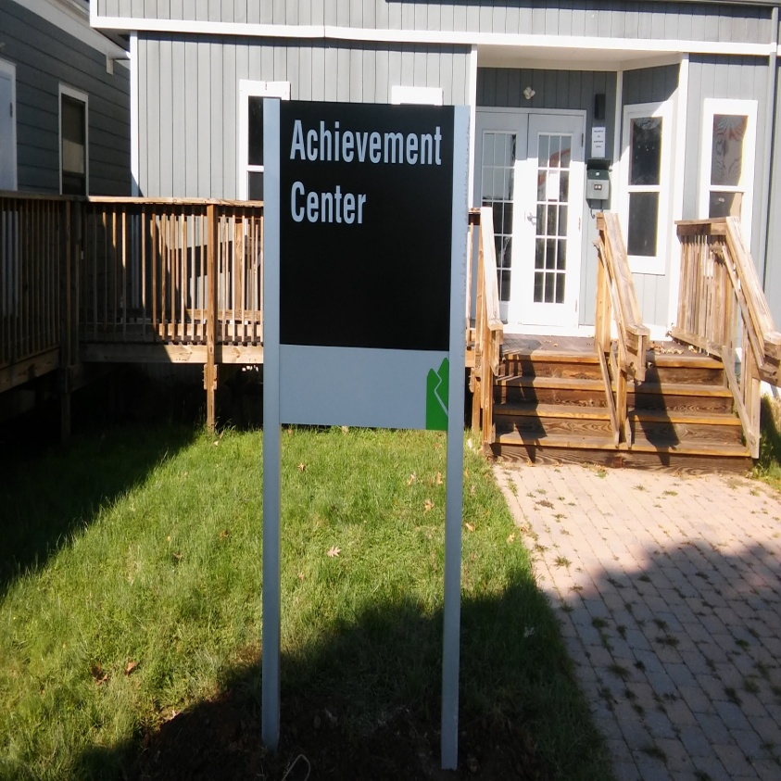
The Achievement Center at Raritan Valley Community College

Slide 2
What is the Achievement Center?
The Achievement Center is a Three-Year Certificate-based post secondary education program for students with intellectual and development disabilities. This college program is a collaboration with Raritan Valley Community College and operated by the Arc of Somerset County.
The Achievement Center is an academic based program to prepare students to transition to college and experience life on RVCC’s campus, while receiving additional support to maximize their success.

Slide 3
New Developments 2023/2024
As we enter our SIXTH YEAR of The Achievement Center at Raritan Valley Community College our curriculum continues to expand. We currently have 40 classes in our Catalog of Classes for students to explore and achieve
20 NEW STUDENTS WERE ACCEPTED in 2023-2024 ACADEMIC YEAR
TEAMWORK TWO (Spring 2023)
INTRODUCTION to ART (Spring 2023)
GOALS (Spring 2023)
DEVELOPMENTAL PSYCHOLOGY (Summer 2023)
COLLEGE SUCCESS (Fall 2023)
LOVE OF MOVIES: Film Appreciation (Summer 2023)
INTERMEDIATE ART (Spring 2024)
INDIE FILMS REFRAMED: 1990 and 2000s Films (Spring 2024)
THE ACHIEVEMENT CENTER in partnership with RVCC was recently awarded with a GRANT by PROVIDENT BANK to create, and hire a STEM INSTRUCTOR to further expand our curriculum.

Slide 4
TAC CLASS OF 2024

Slide 5
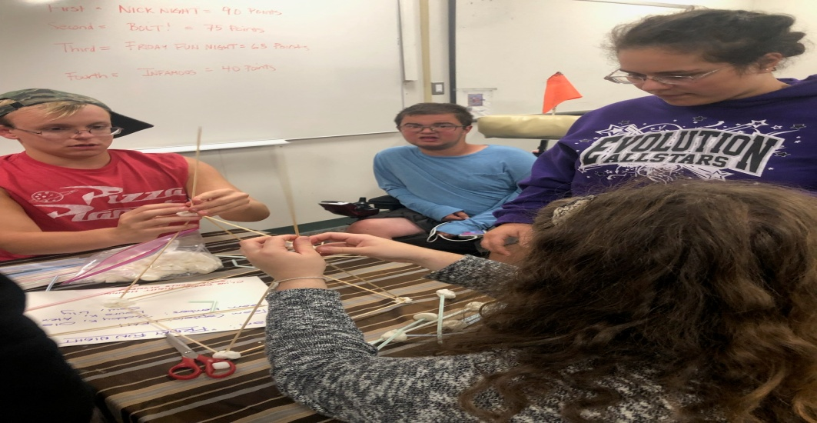
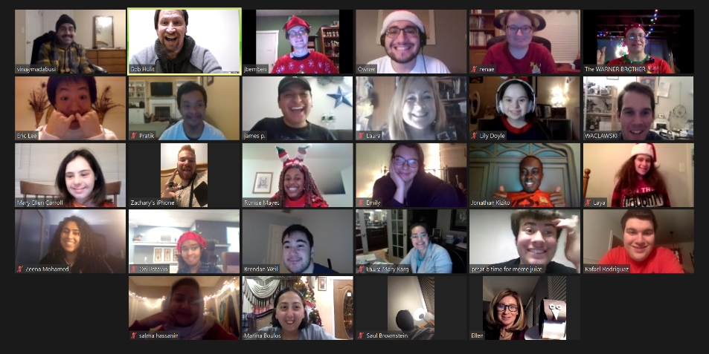
New Developments in 2023/2024
In addition, The Achievement Center offers a bi-monthly Social CLUB FRIDAY NIGHT HANGOUT in the Fall and Spring Semesters. This SPRING SEMESTER 2023/2024 our enrollment rose to 50 students
Overall,130 students WILL PARTICIPATE in The Achievement Center this Academic year between all our program offerings (College Transition Summer classes; Club Friday Night Hangout), and those continuing their post secondary education by enrolling in both our TAC and RVCC classes.

Slide 6
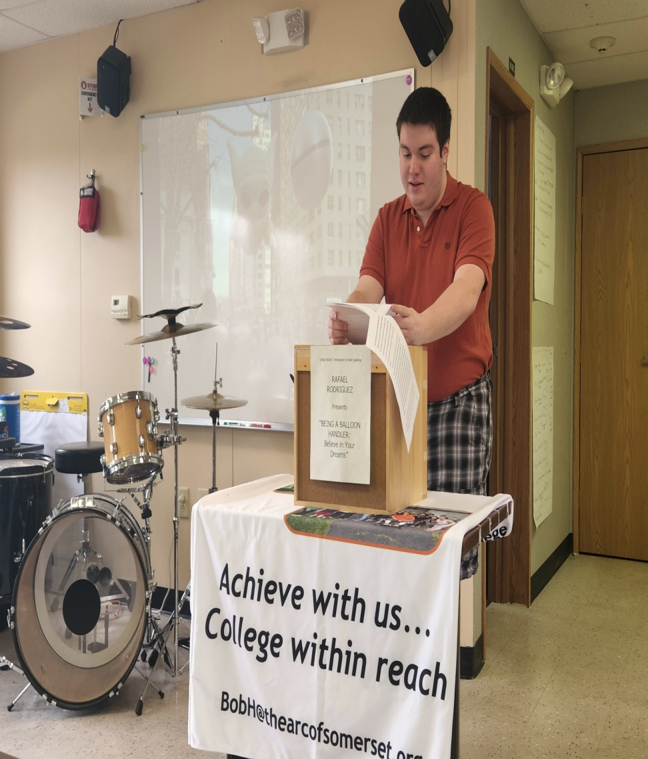
LEARNING YOUR VOICE

Slide 7
CLASSROOM EXPERIENCE
The Achievement Center provides real world college experience inside the classroom. We are an Academic based program.
As with typical college programs, we run our classes in the Fall, Spring, Summer semesters
A typical semester runs 14 weeks with our individual classes running for two hours on a weekly basis.
Students typically take 2 to 3 classes per semester.

Slide 8
CLASSROOM EXPERIENCE
Homework Assignments, Readings, Projects, and Discussion/Participation are important parts of inside and outside the classroom
Learning study habits and note-taking skills builds confidence in our students
Our Year Two and beyond students get introduced to Quizzes, Exams, and other writing assignments such as Essays, Research Papers, Speeches and Computer related topics (Powerpoint, Excel, Photoshop).

Slide 9
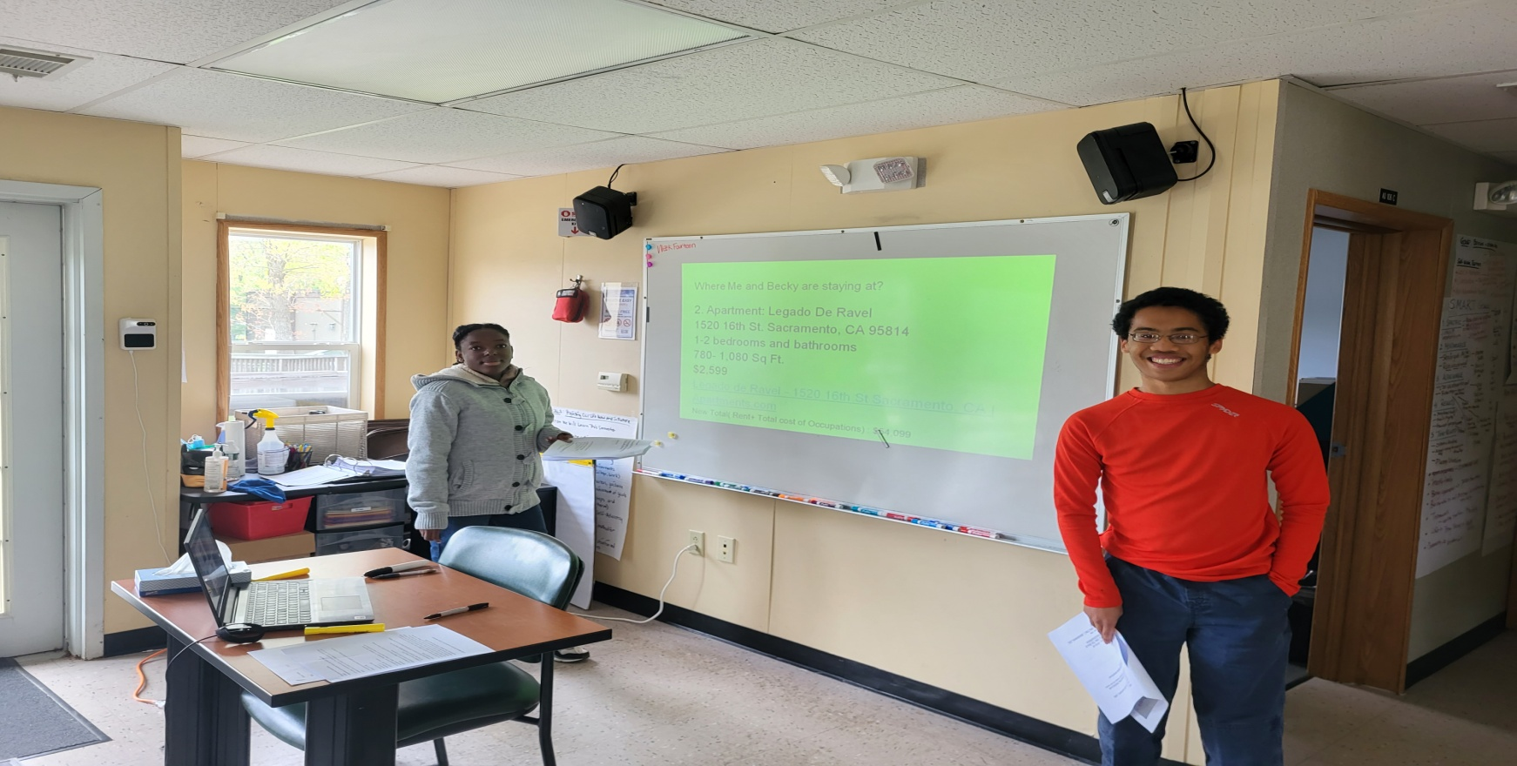
The Achievement Center offers our students an opportunity to “learn their voice” and “seek out new interests” as they acclimate themselves to the classroom and college experience.
Through our series classes, we challenge the students to critically read material (short stories, poetry, novels); explore their writing abilities (Essays, Research papers); communication and social skills training (role plays); career development; and oral presentations. The students build confidence, empowerment, and independence.

Slide 10
TAC = COLLEGE SUCCESS
FROM TAC TO RVCC
Tac successes
FORTY-FIVE TAC
STUDENTS TOOK
RVCC CREDITED
COLLEGE CLASSES
IN THE 2023-24
ACADEMIC CAMPAIGN
THE AVERAGE GRADE FOR TAC STUDENTS WAS
93 (A-)
THREE TAC STUDENTS
GRADUATED RVCC IN 2023 WITH DEGREES and CERTIFICATIONS in COMPUTER SCIENCE, CRIMINAL JUSTICE, and FITNESS SPECIALIST
TAC CLASS ATTENDANCE WAS 98 PERCENT

Slide 11
PEER MENTORS
Peer Mentoring at The Achievement Center is designed to provide our college students a “supporting tool” that provides them with learning skills; self advocacy techniques; assistance in navigating the college campus; reinforcement study habits/time management of their course work.
Peer Mentors put an emphasis on person-centered planning and learning for their students. Peer Mentors will meet with their assigned students on a weekly or bi-weekly basis during the semester to help their students on self-determination, advocacy mechanisms, and promote individual learning. Either through face-to-face communication or through our many secure Social Distancing Remote Platforms through, GOOGLE MEETS, CISCO WEB EX and ZOOM.

Slide 12
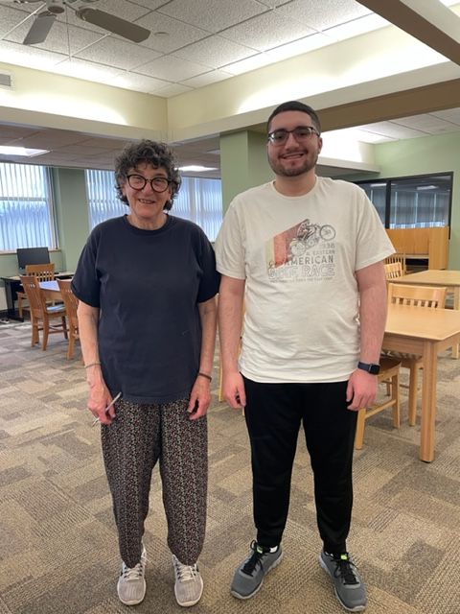
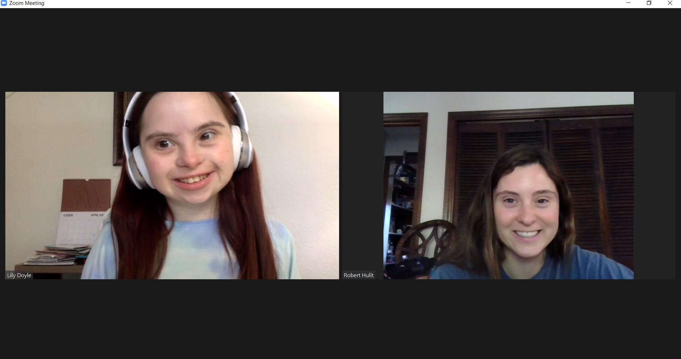
Our Peer Mentors are Raritan Valley current and former students who are aware of the many challenges our students may face both academically (class material/deadlines), and socially (inclusion, confidence-building). In unison with the students, Peer Mentors help identify and develop key skills (Active Listening, Empowerment, Study Habits) for each student.

Slide 13
FROM TAC STUDENT to TAC STAFF
LEAH OSSI
AND
NICK WACLAWSKI
WENT FROM TAC
STUDENTS TO
TAC ALUMNI
TO NOW WORKING
FOR TAC AS PEER MENTORS.
LEAH WAS
RECENTLY HIRED
FULL-TIME AS CURRICULUM ASSISTANT

Slide 14
CLUB FRIDAY NIGHT HANGOUT
Club Friday Night Hangout is a Social Skills based activity and recreational program on the campus of RVCC. Through communication, teamwork, and social bonding members practice skill levels in a fun, safe, and interactive environment.
This group is a mix of high school and current Achievement Center students that participate in many different activities: Art Night; Top Chef Night, Social Skills Olympics, Shark Tank Night, Our Annual Talent Show, MURDER MYSTERY NIGHT; and campus related events, such as the RVCC Planetarium.
Started in the Fall 2018 with EIGHT students, Club Friday Night Hangout enrollment has grown to 50 STUDENTS this FALL 2023. A SUMMER VERSION will start in JUNE 2023.

Slide 15
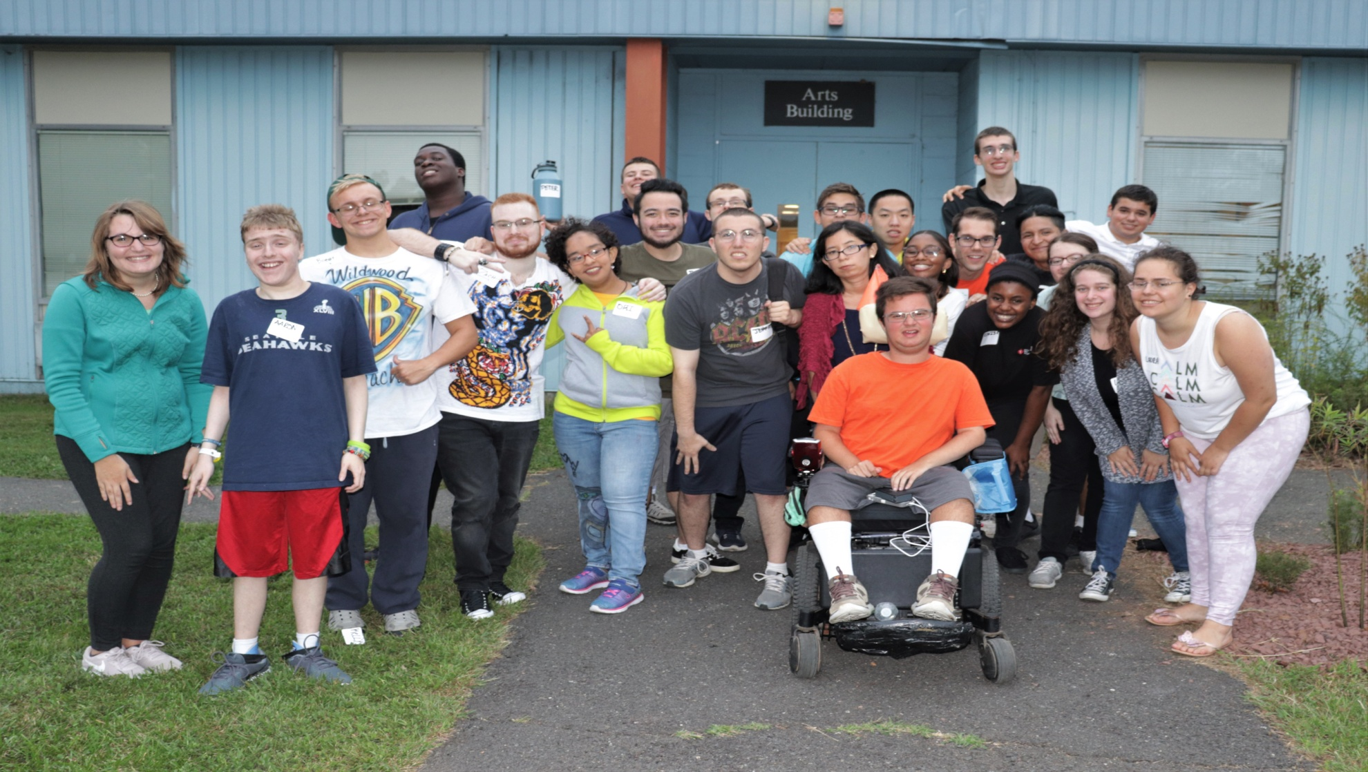
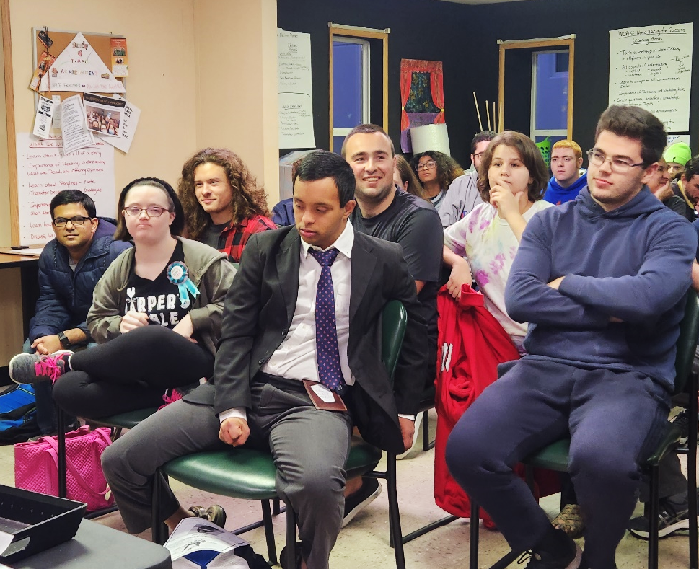
BUILD YOUR SOCIAL SKILLS
COLLEGE IS ABOUT FRIENDSHIPS and RELATIONSHIPS

Slide 16
COLLEGE WITHIN REACH
The Achievement Center at RVCC is waiting for you. Higher education, career development, and social skills awareness are an integral part of a successful education and career paths.
College provides the time and space for you to plan your life the way you want it. It is expanding your interests, making personal connections, civic engagement, and challenging yourself.
College is Within Reach. Come Achieve With Us. Apply Today.

Slide 17
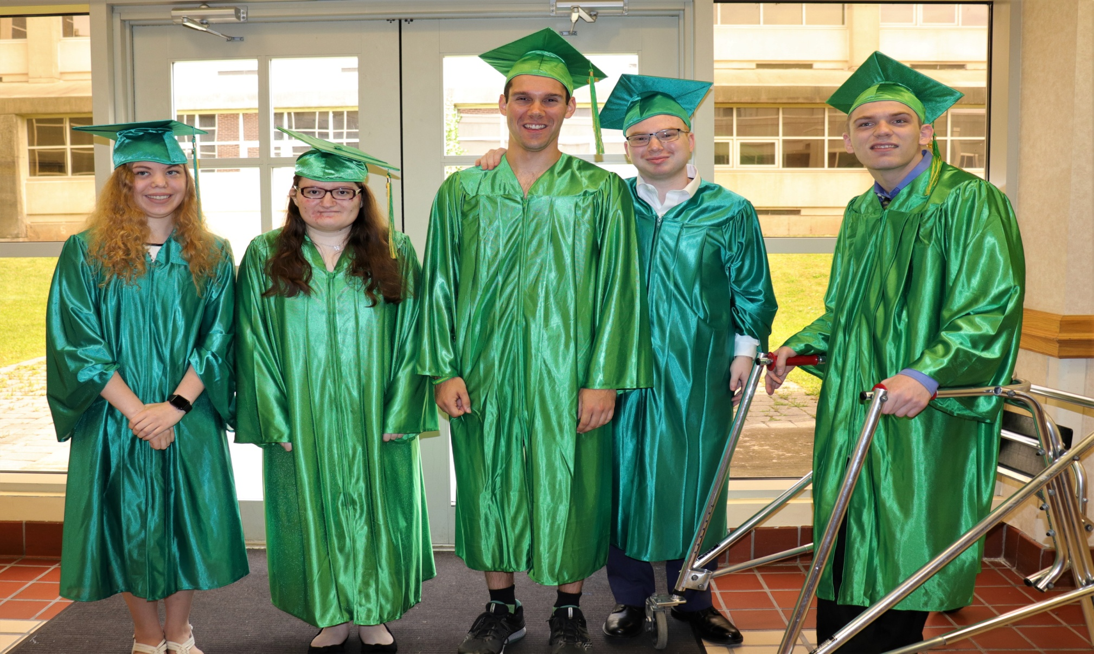
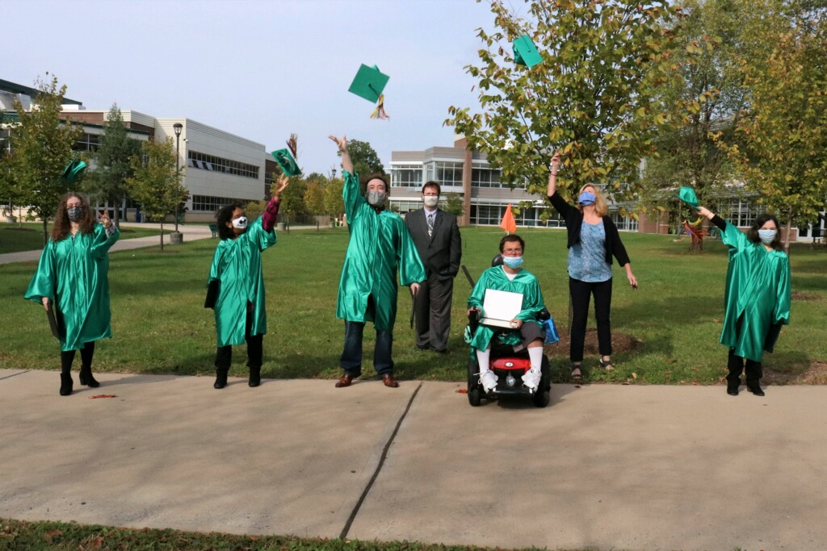
COME ACHIEVE WITH US

Slide 18
Any questions, please call…
Bob Hulit
Director of Post Secondary Programming
2022 Arc of New Jersey Educator of the Year
2021 Somerset County Disability Advocate of the Year
Email: bobh@thearcofsomerset.org
Phone: 732-666-4781
As well as visit The Achievement Center website at https://www.thearcofsomerset.org/the-achievement-center-at-rvcc/

