Slide 1

Mario Lee, Partnership Specialist
New York Regional Census Center
i
2020 Census
i
i
i

Slide 2
Mission and Purpose
i
Mission
To serve as the nation’s leading provider of quality data about its people and economy.
Purpose
To conduct a census of population and housing and disseminate the results to the President, the States, and the American People.
Count everyone once, only once and in the right place.
i
i
i
Notes:
The Census Bureau serves as the nation’s leading provider of quality data about its people and economy. We conduct our work in a manner that maintains the confidentiality and privacy of our respondents, which is of utmost importance.
The Constitution of the United States mandates that a Census be conducted every 10 years. This complete count of every person residing in the United States is shared with the President, the states, and the American public. This information provides the insight for community leaders to be able to make informed decisions.
The goal of the 2020 Census is to count everyone once, only once, and in the right place.

Slide 3
U.S. Census Bureau
i
Largest statistical agency in the U.S.
Leading source of quality data about the nation’s people, places and economy conducting more than 130 Census Bureau Surveys and Programs
      Demographic Programs
        Decennial Census
        American Community Survey
        Current Population Survey
        American Housing Survey
      Economic Programs
        Economic Census (Years ending in 2 & 7)
        Census of Governments (Years ending in 2 & 7)
i
i
i
Notes:
People often ask us what we do in between each census. We are very busy. The Census Bureau collects data on a variety of subjects. To paint a complete a picture of the United States we conduct over 130 Censuses and Surveys. (GO OVER ACS & CPS, and only mention others)
Besides the Census which happens every 10 years, years ending in 0, the Census Bureau conducts the American Community Survey. The American Community Survey is an ongoing survey that provides vital information on a yearly basis about our nation and its people. Through the ACS, we know more about jobs and occupations, educational attainment, veterans, whether people own or rent their homes, as well as other topics.
The Current Population Survey is one of the oldest, largest, and most well-recognized surveys in the United States. The Current Population Survey is sponsored jointly by the U.S. Census Bureau and the U.S. Bureau of Labor Statistics and is the primary source of labor force statistics for the population of the United States. Data from the Current Population Survey is used to calculate the unemployment rate.
The Census Bureau also conducts the American Housing Survey to provide a current and continuous series of data on selected housing and demographic characteristics. Policy analysts, program managers, budget analysts, and Congressional staff use American Housing Survey data to monitor supply and demand, as well as changes in housing conditions and costs, in order to assess housing needs.
The Census Bureau also collects information on the private and public sectors.
Every five years, in years ending in 2 and 7, the U.S. Census Bureau collects extensive statistics about businesses that are essential to understanding the American economy. This official count, better known as the Economic Census, serves as the foundation for the measurement of U.S. businesses and their economic impact. As part of the Census Bureau’s mission to provide timely information on the health of the U.S. economy, this “business” census serves as the most extensive collection of data related to business activity. Nearly 4 million businesses, large, medium and small, covering most industries and all geographic areas of the United States will receive surveys tailored to their primary business activity.
The Census of Governments is also conducted in years ending in years ending in 2 and 7. The Census of Governments identifies the scope and nature of the nation's state and local government sector; provides authoritative benchmark figures of public finance and public employment; classifies local government organizations, powers, and activities; and measures federal, state, and local fiscal relationships. Information provided by the Census of Governments include; how governments are organized, government employment and payroll, and government finances.
Both the Economic Census and the Census of Governments have related surveys that are conducted quarterly and annually to provide ongoing insight to the United States public and private sectors.

Slide 4
2020 Census
i
Mandated by Article 1, Section 2 of the U.S. Constitution
Conducted every 10 years since 1790 (years ending in zero)
Counts every resident in the United States where they live and sleep most of the time
Increasingly diverse and growing population
330 million people
Over 140 million housing units
Confidential
Responses are protected by Federal Law
Responses are only used to produce statistics
i
i
i
Notes:
Let’s get started with the 2020 Census….
As I mentioned , the Census is mandated by the United States Constitution and has been around since 1790.
In 1790, Thomas Jefferson was director of the first census. Then In 1790, they only needed 650 enumerators to count 3.9 million residents in 13 states. At the time New York City was the largest urban place with 33 thousand people. In 2010, the Census Bureau needed about 635 thousand enumerators to count a population of about 308 million people
To give you an idea of the magnitude of conducting a Census, A Census is the largest U.S. peacetime mobilization and operation conducted.
In 2020 we will be attempting to count over an estimated 330 million people in 140 million households.
The law requires the Census Bureau to keep your information confidential. Your responses are only used to produce statistics
All Census Bureau workers take a legally binding, lifetime oath to protect your information. Anyone who violates that oath could face jail time, a $250,000 fine, or both.

Slide 5
Uses of Census Information
i
Determines the number of seats each state has in the U.S. House of Representatives
Defines congressional and state legislative districts, school districts and voting precincts
Determines how more than $675 billion dollars in federal funding are spent on infrastructure, programs and services each year
Informs government, business and community planning and decisions
Provides business and nonprofit organization with critical information for planning decisions
Provides population benchmarks for nearly every other United States survey
i
i
i
Notes:
Why do we conduct the Census? The primary purpose of the decennial census is to apportion seats in the U.S. House of Representatives among states.
Additionally…
States and local governments use Census data to draw congressional and state legislative districts, school districts and voting precincts.
Federal Agencies use Census data to distribute over $675 billion each year to the states.
Census data are used by federal, tribal, state, and local governments to make informed decisions for their communities.
Also, businesses and nonprofit organizations use Census data to meet the needs of the populations they serve. For example, an entrepreneur might research where to locate a new business venture based on demographics and income in a particular area, as well as the size of the target market.

Slide 6
Data Protection
i
i
Responses are protected by Federal Law (Title 13) and are only used to produce statistics.
Personal information collected by the Census Bureau cannot be shared with any government agency or court.
Census Bureau employees are sworn to protect confidentiality for life.
Violating Title 13 is a federal crime with severe penalties, including a federal prison sentence of up to five years, a fine of up to $250,000, or both.
Cybersecurity program meets highest and most recent standards.
  Data encrypted to protect privacy; restricted access; responses kept on private, internal network behind firewalls
i
i
i
i
i
i
Notes:
Protecting the data we collect is a top priority. More importantly, it’s the law…. The Census Bureau is bound by Title 13 of the United States Code. These laws not only provide authority for the work we do, but also provide strong protection for the information we collect from individuals and businesses.
Title 13 provides the following protections to individuals and businesses who provide information to the Census Bureau:
Personal information cannot be shared with any government agency or court.
Census Bureau employees are sworn to protect confidentiality. Every person with access to your data is sworn for life to protect your information and understands that the penalties for violating this law are applicable for a lifetime.
Violating the law is a serious federal crime, and penalties include a federal prison sentence of up to five years, a fine of up to $250,000, or both.
Because we are conducting the 2020 Census online, it is absolutely critical that we have secure systems in place. We are working with cybersecurity experts in the private sector and in the intelligence community to ensure our program meets the highest standards.

Slide 7
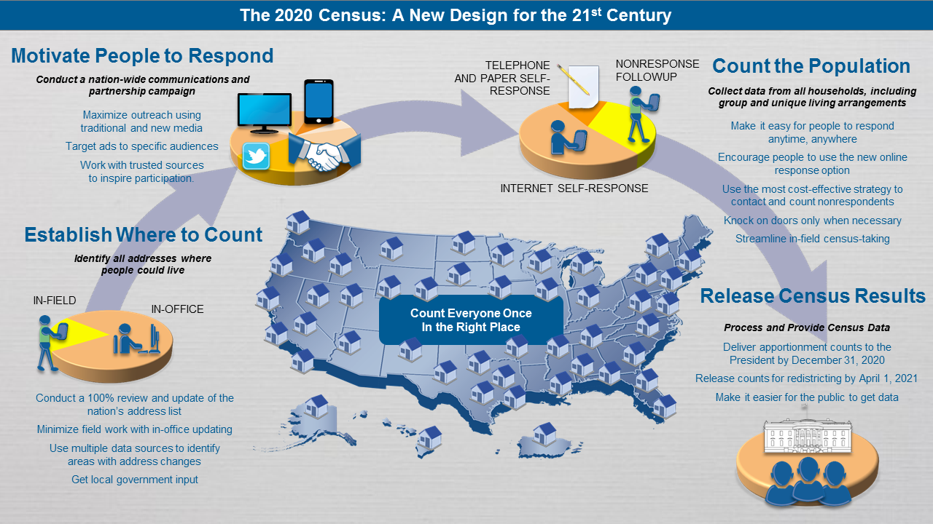
i
Design for 2020 Census
i
i
i
Notes:
This slide illustrates our design plans for the 2020 Census. To get an accurate count, the Census Bureau must build an accurate address list of every housing unit, maximize self-response to the census, and efficiently follow up with those who do not respond. (DON’T SPEND A LOT OF TIME ON THIS SLIDE)
First, we have to establish where to count people. This step will create our final list of addresses where we expect a response for the census. We maintain a Master Address File, which is updated throughout the decade using Postal Service Updates, staff updates from work on current surveys, and we’ve also gotten input from local governments through the LUCA program to make sure that we have the most accurate address list possible. This is the foundation for the census.
Once we establish where to count the population, we need to motivate people to respond. We will have a national communications and partnership campaign, we’ll work with local leaders to educate the population on the importance of completing the census, and we’ll use new media platforms (Facebook, Twitter, etc.) as well as traditional media to maximize outreach.
Finally we have to count the population. The 2020 Census will be the most technologically advanced census ever conducted… For the first time, we’ll be able to respond online, by phone or by mail.
We will mail notifications in mid-March 2020 inviting households to go online and fill out their census. A few reminder mailings will be sent, and by mid-April we’ll send a paper questionnaire to any nonresponding housing unit. Eventually, we will send enumerators out to visit the addresses who do not respond on their own. The more people we can persuade to respond online (or by phone or paper) the better off we will be in terms of the total cost of the census since sending enumerators in person drives up the cost.
All of this is done so that we can deliver the apportionment counts to the President of the United States by December 31, 2020.

Slide 8
Responding to the 2020 Census
Language Assistance
i
Internet Self-Response and Census Questionnaire Assistance
  12 Non-English Languages
Enumerator Instrument, Bilingual Paper Questionnaire, Bilingual Mailing, Field Enumeration Materials (Spanish)
Language Glossaries, Identification Cards and Guides (Video and Print)
  59 Non-English Languages
  Includes American Sign Language, braille, and large print
  Hiring at the Community Level
i
i
i
Notes:
In terms of responding to the census, we have developed a strong language assistance program to help us get the best possible self-response rates.
Online response will be supported in 12 non-English languages, as will our telephone questionnaire assistance (Spanish, Chinese, Vietnamese, Korean, Russian, Arabic, Tagalog, Polish, French, Haitian Creole, Portuguese, Japanese)
Mailings will be bilingual in English and Spanish.
We also plan to have language materials, such as language guides, available in 59 non-English languages.

Slide 9
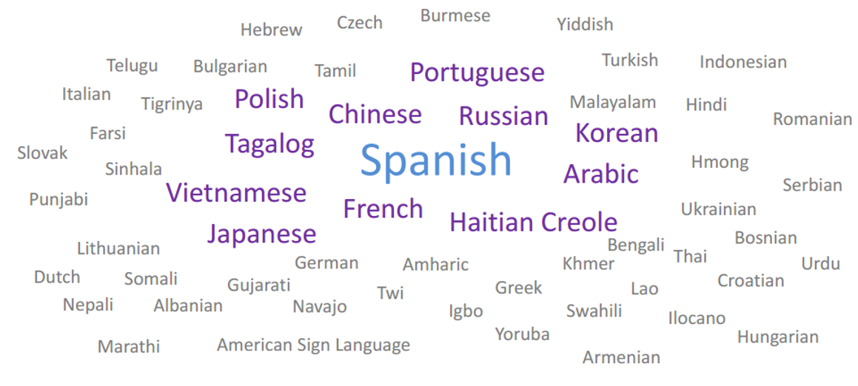
2020 Census Language Accessibility
i
i
i
i
Notes:
These are the languages for which we are providing some assistance. The languages in the center in bold text are the 12 languages available for online and phone response.

Slide 10
i
Looking Ahead to Census 2020
2018
  Partnership Program - Launch of the Partnership Program
  Recruitment Begins
  Complete Count Committees - Formation of SCCC/CCCs
2019
  Open Wave 1 Field Offices (Jan – Feb)
  Open Wave 2 Field Offices (Jun – Jul)
2020
  Advertising - Begins in early 2020
  Census Day - April 1, 2020
  Nonresponse Follow-up - Begins in March and continues through July
  Apportionment Counts to the President - December 31, 2020
2021
  Redistricting Counts to the States - By April 1, 2021
i
i
i
Notes:
Here is a summary of key milestones as we prepare for the 2020 Census.
In 2018 we officially launched the partnership program. We are reaching out to establish partnerships and begin forming Complete Count Committees.
We are recruiting and hiring staff throughout the region. We are hiring Partnership Specialists, office staff for the field offices and field staff to conduct some of the early in-field operations.
We are opening field offices while we continue to build our pool of partners and Complete Count Committees. In Late 2019 the Census buzz will begin.
In early 2020 the media campaign will be in full swing as we prepare for Census Day, April 1st. We will begin knocking on doors in March in some areas, though most of the non-response follow-up work will begin in mid-May and continue through July.
The Apportionment Counts will be delivered to the President - December 31, 2020
In 2021, we will deliver redistricting Counts to the States - By March 31, 2021

Slide 11
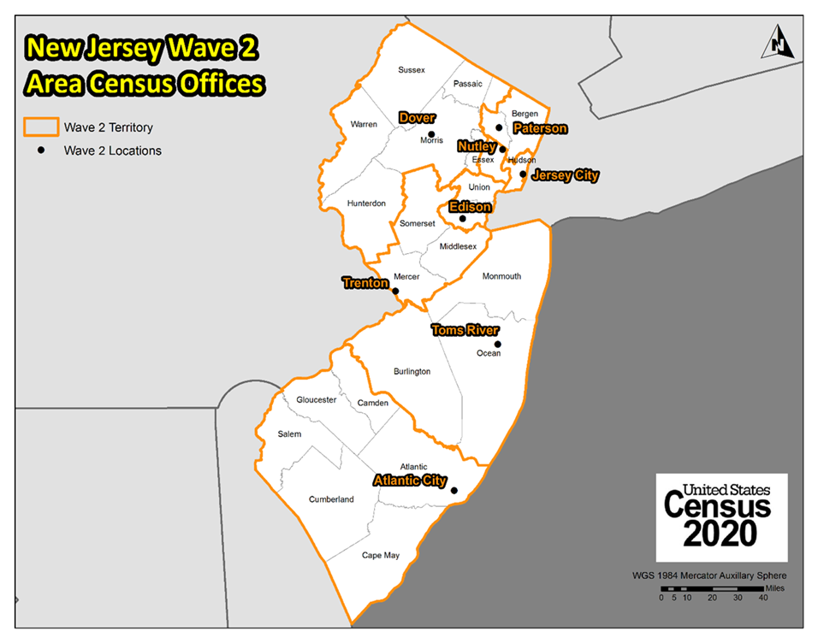
i
Area Census Offices
i
i
i
Notes:
We plan to have 6 field offices in Massachusetts, and they are all Wave 2…
Boston, Lawrence, Quincy, Taunton (actually in East Bridgewater), Waltham, Worcester

Slide 12
2020 Census Recruiting
i
Post link to 2020 jobs website on your landing page
Email blast to your community members about job opportunities
Identify locations where computer resources/internet connectivity is available for community members
Host Census Hiring events in your local community
Invite Census staff to speak to local leaders about job opportunities
2020census.gov/jobs (one application for chance at multiple positions)
Census Takers/Enumerators, Area Census Office clerical positions, Office Operations Supervisors, Census Field Supervisors, Recruiting Assistants
USAJobs.gov (one application for each distinct job posting)
Partnership positions, Area Census Office Management positions
Recruitment Toolkit
i
i
i
Notes:
Recruiting for the 2020 Census is an enormous task on its own, and this is one of the areas where we need the most help from partners. We need to recruit tens of thousands of people across the New York region to have enough qualified applicants in the pool when we start hiring for the field operations. You can help by posting information about the jobs on your website or landing page, emailing your community members about job opportunities, identifying locations with computer resources and internet connectivity where people can apply for jobs, hosting hiring events, and inviting Census staff to speak about job opportunities.
There are two websites where Census jobs can be accessed:
2020census.gov/jobs is where people can apply for the enumerator positions, some of the Area Census Office support positions, and a few other positions.
usajobs.gov is the website where we post the Partnership Specialist positions, and the Area Census Office management positions

Slide 13
i
2020 Census Environment
2020 Census
Constrained fiscal environment
Rapidly changing use of technology
Distrust in government
Informal, complex living arrangements
A mobile population
Declining response rates
Increasingly diverse population
i
i
i
Notes:
As you can imagine this will be a different Census and as we plan our approach, we will have to be aware of other upcoming challenges. The 2020 Census will be conducted in a rapidly changing environment, requiring the Census Bureau to be flexible to be able to navigate our way to a successful 2020 Census. And as we thought about planning the census we must design the Census for both the environment today – and what we believe the environment to be like at the time of the Census.
This image displays some of the predicted constraints that we have identified as we began the design of the 2020 Census. A few of the challenges we are experiencing include: (PICK A COUPLE TO MENTION, DO NOT COVER ALL)
Declining response rates - Response rates for Census Bureau surveys and for surveys and censuses in general have declined as people are overloaded with requests for information and become increasingly concerned about sharing information. People are inundated with information and one more request is just that, one more request. We recognize that we need to combat the apathy and motivate people to respond.
Planning for the increasingly complex living arrangements and population – Households are becoming more diverse and dynamic, making it a challenge to associate an identified person to a single location. For example, blended families may include children who have two primary residences. Additionally, some households include multiple relationships and generations. Factors we need to take into account as we are thinking about how we are going to conduct the Census, and how we are going to ensure we are going to count everyone.
A very mobile population – Based on data from the American Community Survey, the population of the United States continues to be a highly mobile, as about 12 percent of the population moves in a given year (2012-2013 and 2013-2014 ACS Data).
Constrained fiscal environment: Budget deficits and a recovering labor market place significant pressure on funding available for the research, testing, design and development work required for successful innovation.
Information explosion: Rapid changes in information technology create stakeholder expectations for how the Census Bureau interacts with the public to obtain and disseminate data products.
Declining response rates: Response rates for Census Bureau surveys and for surveys and censuses in general have declined as people are overloaded with requests for information and become increasingly concerned about sharing information.
Distrust in government: Concerns continue to grow about information security and privacy, the confidentiality of information given to the government, and how government programs will use the information collected. This makes it more difficult to collect important demographic survey information.
Increasingly diverse population: The demographic and cultural make-up of the United States continues to increase in complexity, resulting in a growing number of households and individuals who do not speak English as their native language, who have a wide variety of cultural traditions and mores, and who may have varying levels of comfort with government involvement.
Rapidly use of technology - The last challenge to point out today is technology. This is a Census that we are infusing technology throughout the entirety of the Census which brings innovation, new ideas, efficiency, and increased quality but it also brings a challenge. We are building technological advances are built today, yesterday, or last year for a Census we are going to conduct in 2020, this is a challenge we have to take into consideration as we plan for the Census.

Slide 14
Overcoming Obstacles through Partnerships
i
Your Trusted Voice to encourage everyone’s participation
Local knowledge and insight of the community to reach everyone with the Census Bureau’s messaging
  The impact of a complete count for the community
  2020 Census will count every person living in the U.S.
  Privacy; Confidentiality of responses
  Employment Opportunities
i
i
i
Notes:
We know we are facing many challenges ahead, and we also know that we cannot conduct the Census alone. That’s what our Partnership Program is all about. While this is a national effort, the Census is completed at the community level. We are reaching out and developing relationships with local leaders and stakeholders. Partners have knowledge and insight of their community that the Census Bureau doesn’t necessarily have, which will be critical in helping us reach everyone.
We need our partners to help us raise awareness of the 2020 Census in their communities and motivate their members to respond. We also need partners’ help in recruiting the staff we’ll need to get the job done.
Our partners’ trusted voices carry weight and influence in the community. When you share our messaging, the community will listen.

Slide 15
Our Partners
i
Elected Officials
Colleges and Universities
School Districts
Libraries
Government Offices
Community Organizations and Associations
Media Outlets
Local Businesses
i
i
i
Notes:
The partnership program is meant to engage the community at the grassroots level in order to reach everyone in the community. We want to partner with every trusted voice in the community.
The trusted voices in the community have the power to motivate diverse communities to participate in the Census, mobilize other community leaders to engage their constituents, and reach populations with historically low response rates and who are considered hard to count.
For reference (JUST MENTION A FEW, DON’T SPEND MUCH TIME HERE):
Elected Officials – As leaders in the community, the public often reaches out to them for guidance on various topics.
Colleges and Universities – Counting the student body will be difficult. Colleges and universities will be able to deliver the census message to students with their own census campaigns.
School Districts – Educators are trusted voices in communities. Educators are resources for the community. Also, by utilizing Statistics in School materials students are being exposed to the Census Brand.
Libraries - Libraries are another community resource that the public turn to for information. Also, public libraries are equipped with technology that public can use to apply for census jobs and/or respond to the census.
Government Offices - Government offices at all levels are a public resource. They can use their knowledge and interaction of the community
Community Organizations and Associations - As community resources in the community, the public often reaches out to them for guidance on various topics.
Media Outlets – Media outlets are able to reach the community with broadcasting census public service announcements on the employment opportunities and response to the Census.
Local Businesses – As established resources in the community, businesses can share the Census message their employees and share the census message with their customers.

Slide 16
Partnership Initiatives
i
Complete Count Committees
American Indian and Alaska Native Program
Community/State and Local Networks
Faith-Based Community Outreach
Foreign Born/Immigrant Program
Higher Education Program
Lesbian, Gay, Bisexual, Transgender and Questioning/Queer Outreach
Mobile Response Program
i
i
i
Notes:
The Census Bureau is also taking special initiatives to ensure that every community in the United States is reached. And, we hope to engage our partners to help us with these efforts.
Complete Count Committees will be instrumental in the 2020 Census. This is a group of community stakeholders who come together to identify any obstacles and solutions to ensure that their communities participate in the 2020 Census.
We will also have other initiatives that target specific population groups (JUST MENTION A FEW):
American Indian and Alaska Native Program focuses on support Federal Recognized, State Recognized, Non Recognized and AIAN living on and off Tribal Land. The program includes Tribal Government Liaison program, Tribal Complete Count Committees (TCCCs) and partnership with Organizations supporting AIAN populations.
Community/State and Local Networks. We will form relationships and partnerships with local organizations in the community working with populations in low response score areas to help them understand the benefits and impacts of the 2020 Census. These partners will help us promote self-response and add value to the census by providing the use of their established communications network.
Faith-Based Community Outreach focuses on engaging faith-based leaders as census ambassadors. These leaders will promote the census and motivate their congregations or members to participate in the census. Faith-based partners are especially helpful in specific ethnic communities and other low response areas.
Foreign Born/Immigrant Program has a crucial role in conducting an effective outreach to the foreign born population and will contribute to the ultimate goal of reducing the undercount during 2020 Census. There is an increased fear of deportation and distrust of governmental agencies within the immigrant communities. We need to respond with innovative strategies for overcoming this population’s fears to accomplish the mission.
Higher Education Program is to conduct outreach to all enrolled students and surrounding communities (typically students who live off campus). The Higher Education Program for the 2020 Census will include four-year colleges and universities, community colleges, vocational schools, trade schools, adult educational facilities and other career colleges.
Lesbian, Gay, Bisexual, Transgender and Questioning/Queer Outreach LGBTQ communities often have similar experiences that are common among populations living in low response score areas such as historical mistreatment and high levels of stigmatization. We will integrate LGBTQ outreach into existing efforts to reach people living in low response score areas and improve outreach.
Mobile Response Table will be identified through the local knowledge of census staff and community leaders. These outreach events will give the public the opportunity to self response using mobile devices to complete the 2020 Census.
Trusted Voices is an individual or group with relevance, importance and relatability to a given populations. These respected spokespersons can articulate the importance of the 2020 Census and encourage self response.
Thank You Campaign will recognize the efforts of our partners in supporting the 2020 Census.

Slide 17
How We Support Partners
i
Promotional Materials and Content
  Flyers, Fact Sheets
  Posters
  In-language
  Toolkits
  Social media content and links
  Sample message for email or blog; drop in articles
  Graphics
census.gov/partners/2020-materials
2020census.gov/en/partners/outreach-materials
Partnership presence
Connecting Partners with other partners
Data Services
i
i
i
Notes:
We know that our partners are very busy and we want ease the burden on our partners so we provide as much information and materials as possible.
We will provide you with materials to deliver the Census message. We provide partners with sample email messages, language for drop in articles, and social media content that you can copy and paste, or tailor for your community members. We will also provide Fact Sheets and FAQs about the 2020 Census and our activities.
Another way we provide support to partners is by being available to participate in your events, where we are able to directly engage and interact with the community and address any questions face to face.
We will be here to support you every step of the way, and look forward to working directly with you.

Slide 18
Partnership Activity Examples
i
Participate in a Complete Count Committee
Host events (hiring, response)
Allow the Census Bureau to participate in events
  Speaking opportunities
  Presence at events
Share the Census message/job opportunities
  Social media
  Newsletters
Assist with Census operations
  Recruiting (identify locations with computer resources/ internet connectivity)
  Response activities
i
i
i
Notes:
People will always ask, “what are census partners obligated to do?”
We are aware that every partnership is unique. Here are some examples of what partners are doing:
Participate in a Complete Count Committee:.
In the past, some partners held specific events to raise awareness about responding to the Census or the employment opportunities with the Census Bureau. Examples of the events would range from a media kick-off promoting the census, a job drive for possible applicants, or an outreach events to promote participation to the Census.
Allowing Census Bureau staff the opportunity to have a presence at your events speaks volumes to the community. We are available to speak at or participate in your events to share the Census message.
Some other ways that you can help the Census Bureau is to share the message through social media or your newsletters. We provide you pre-packaged the information so all you have to do is drop it in your social media or newsletters.
Some partners are able to support the 2020 Census by providing us use of their resources. Since applicants will be able apply for jobs online and respond to the Census online, computer resources are extremely beneficial for those who don’t have internet access at home. We would like to partner with organizations with technological resources that would be able to open their doors and allow the Census Bureau to invite applicants and respondents to participate in the Census.

Slide 19
i
Complete Count Committee
What is a Complete Count Committee?
A group of government and community leaders who come together to raise awareness about the 2020 Census and motivate their community members to respond.
Who should be on the Complete Count Committee?
Elected leaders, school department, libraries, workforce development, immigrant organizations, faith based leaders, senior services, community development and housing, community based organizations, veterans services, higher education, business, media (not an exhaustive list).
  How do we get started?
  Appoint a chair; identify the individuals/groups to include; plan a kick-off meeting; form subcommittees to be dedicated to specific areas of need.
i
i
i
Notes:
Our Complete Count Committee initiative will be critical to the success of the 2020 Census. A CCC is comprised of a broad spectrum of government and community leaders who come together to raise awareness about the census and motivate people to respond. These leaders develop and implement an awareness campaign to encourage response, based upon their knowledge of the local community.
Every municipality has a vested interest in a complete count of its population, and through this vehicle cities and towns will have the opportunity to participate in the effort and influence the outcome.
CCCs operate independently from the Census Bureau, while working closely with the local Partnership Specialist, who serves in an advisory capacity.
They promote the census through locally based, targeted outreach efforts. Local leaders and influencers are trusted voices who can motivate community members to respond to the census. Those same trusted voices can help recruit other committee members who have the expertise needed to reach the most hard to count populations, as well as the resources that will be needed to supplement the Census Bureau’s promotional materials.
Committees are being formed at the state level, regional level, municipal level and at the community level. They will serve as communication vehicles in their communities for the promotion of the Census. We will look to the committees for assistance with promoting job opportunities as well as response to the Census.
Strong Complete Count Committees are:
-As inclusive as possible
-Bi-partisan
-Comprised of a coalition of government officials, community groups, businesses, and other public serving entities
We can help you get started when you are ready to form a Complete Count Committee, and we can assist and provide guidance along the way, including training.

Slide 20
i
Complete Count Committee: Subcommittees
Focus on different facets of the community.
Allow a more targeted approach to reach a specific audience.
Devoted to reaching populations that may not respond or may be undercounted.
Business
Community Based Organizations
Pre-K through 12 grade
Colleges & Universities
Ex-Offenders
Faith-Based
Government
Homelessness
Library
Philanthropy
Race & Ethnic
Recruiting
Senior Citizen
Veterans
i
i
i
Notes:
Some committees will form subcommittees to focus on specific parts of the community. Subcommittees allow for a more pointed approach - they can devote their efforts to reaching a particular audience that may need a greater level of education or motivation before responding.
These are the types of subcommittees that will likely be formed. Each subcommittee can focus on reaching the targeted population through local leaders and trusted voices. This approach will be critical in reaching some of the hard to count groups.

Slide 21
i
Committee/Subcommittee Activities
Appoint a Census Liaison
Develop a local advertising campaign
Post Census information on website and social media
Print materials
Run PSAs on local media outlets
Translate Census materials and tailor messaging for your community
Provide a Census Bureau presence/Host 2020 Census events
Media Kick-Offs
Outreach events (Recruiting and Response)
Provide a space for Census Bureau staff at local events
Create sub‐committees to reach all groups
i
i
i
Notes:
These are some of the activities Complete Count Committees engage in.

Slide 22
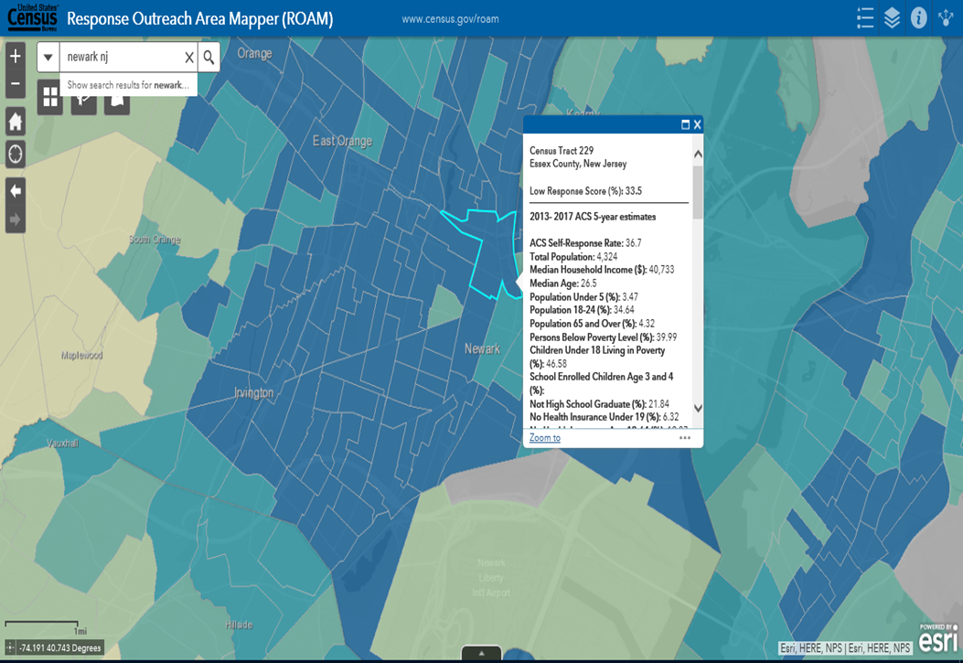
Response Outreach Area Mapper (ROAM)
i
Housing
Demographic
Socioeconomic
Data at the Census tract level
Available to the public
census.gov/roam
i
i
i
Notes:
At the Census Bureau we believe in taking a data-driven approach to solve problems. To that end, we have developed a tool that can assist Partnership Specialists and community leaders to plan at the local level where we anticipate a low response.
You are looking at a screenshot from an interactive mapping application called the Response Outreach Area Mapper, or ROAM. This tool was developed to make it easier to identify hard-to-survey areas and to provide a socioeconomic and demographic characteristic profile of these areas using American Community Survey (ACS) estimates. ROAM allows the user to visualize areas that are considered hard to survey down to the census tract level. The hard-to-survey areas are represented by the darker shading. Each tract has a Low Response Score, which represents the predicted mail non-response rate.
Areas can be hard-to-survey for different reasons. Drilling down and learning about these areas allows us to create a tailored communication and partnership campaign, and to plan for field resources including hiring staff with language skills.
The website is pretty straightforward… Simply highlight a census tract by clicking on it, and view the characteristics of that tract.
This tool is available for public use at the website shown.

Slide 23
Data Dissemination Program
i
Free Resource to YOU
Opportunities to teach the public how to access our data
Data Presentations
Data Access Workshops and Training Sessions
Webinars
Data and Survey Inquiries
All tools and data available at www.census.gov
American FactFinder
Census Business Builder
My Congressional District
OnTheMap
i
i
Subscribe and learn more:
www.census.gov/academy
i
Notes:
I don’t want to leave here today without mentioning the Census Bureau’s Data Dissemination Program. This program was developed to help you understand and utilize the vast array of data we have available on our website. This is a FREE program, a service we provide to give back to our partners and communities. Our expert staff can customize a training workshop for you or your constituents. Trainings can be done in person or via webinar. Our staff are well-versed in the data tools available on our website, including American FactFinder, Census Business Builder, My Congressional District and others.
The Data Dissemination staff are available to our partners for events to help educate people on the uses of the data.

Slide 24





Connect With Us
i
www.2020census.gov
facebook.com/uscensusbureau
twitter.com/uscensusbureau
youtube.com/user/uscensusbureau
instagram.com/uscensusbureau
linkedin.com/company/us-census-bureau
i
i
i
Notes:
We are very active on social media, so add us!

Slide 25
i
Contact Us
Partnership Program
Phone: (212) 882-2130
Email: new.york.rcc.partnership@2020census.gov
Website: https://www.census.gov/partners/2020.html
Census Jobs
Field & Office Job Opportunities
Website: www.2020census.gov/jobs
Office Managerial Job Opportunities
Website: www.usajobs.gov
Website: www.census.gov/about/regions/new-york/jobs.html
Data Dissemination Program
Email: census.askdata@census.gov
Phone: 1-844-ASK-DATA
Website: www.census.gov/data/training-workshops.html
i
i
i
Notes:
If you have any questions about any of the information we’ve covered here today - or anything Census related - don’t hesitate to contact me. If I don’t know the answer, I will find someone who does and get back to you. My contact information is on the screen.
Are there any questions?
Thank you!

